Slide 1

Solutions to perinatal loneliness
Dr Ruth Naughton-Doe – NIHR Three Schools Mental Health Postdoctoral Research Fellow (Award number MH501)
November 2022-June 2024 (and beyond)
NIHR Yorkshire and Humber ARC
Mental Health Social Care Research Centre, University of York
Notes:
Story of the research – why I became interested. About the funder.

Slide 2
Overview of presentation
Background to the project
Research journey
How did parents experience perinatal loneliness?
Film: perinatal loneliness – lonely times.
Why did participants think they felt lonely?
What did they want to change? What were their ideas for support?
Next steps for the research

Slide 3
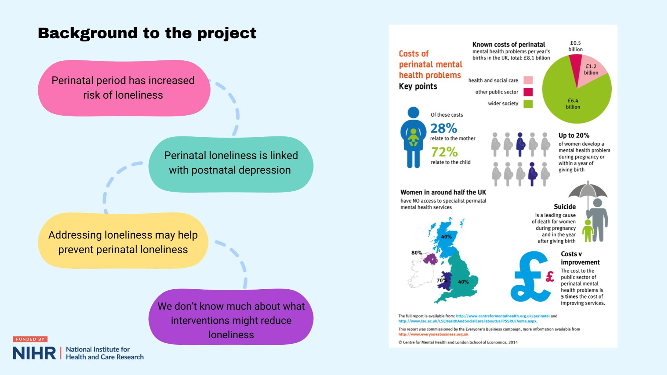
Notes:
Maternal mental health crisis. 20% of parents experience postnatal depression. This may be an underestimate as it is not routinely screened.
A study by the British Red Cross found that more than 80% mothers under the age of 30 had feelings of loneliness some of the time, while more than 50% said they felt lonely all the time. Loneliness is linked with perinatal mental health problems, which are mental health issues that arise from conception to up to two years post-birth, including for parents who adopt. Perinatal mental health issues affect up to 20% of all parents.

Slide 4
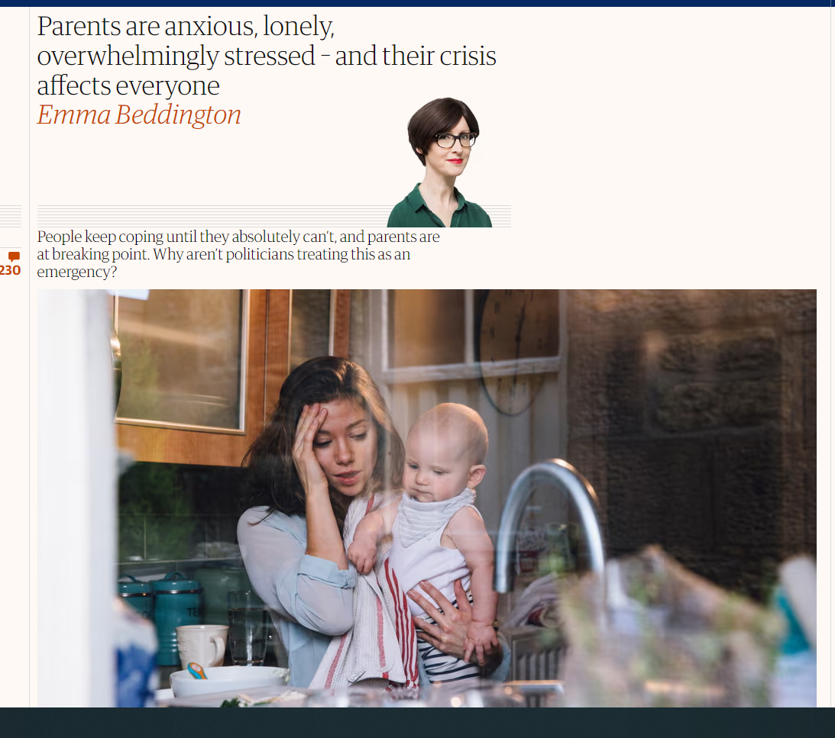
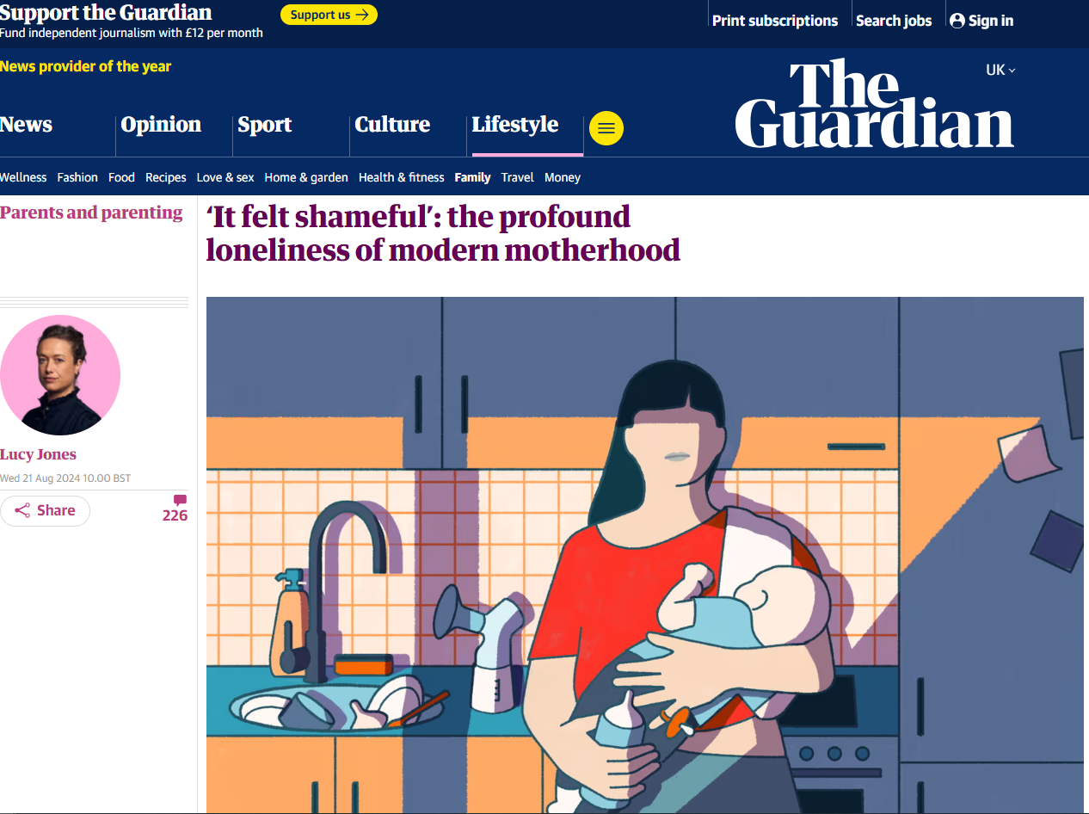
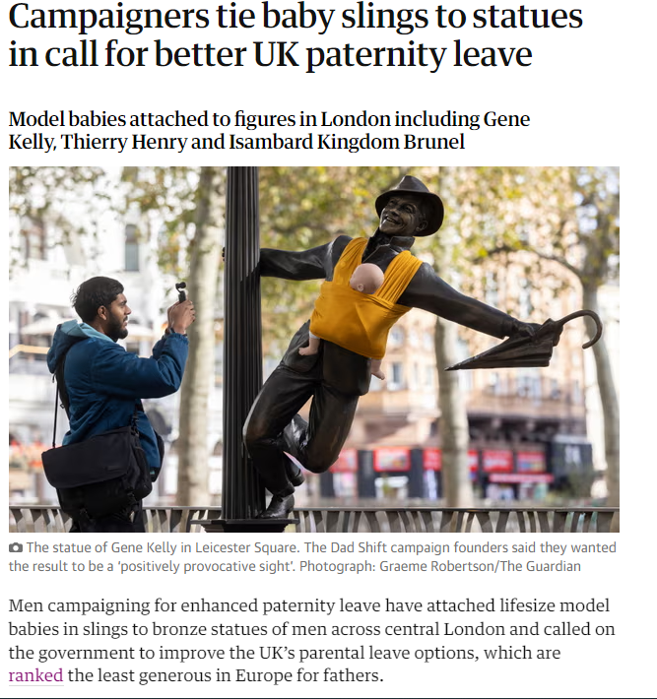
Why was this research needed?
Notes:
20% of parents experience postnatal depression

Slide 5
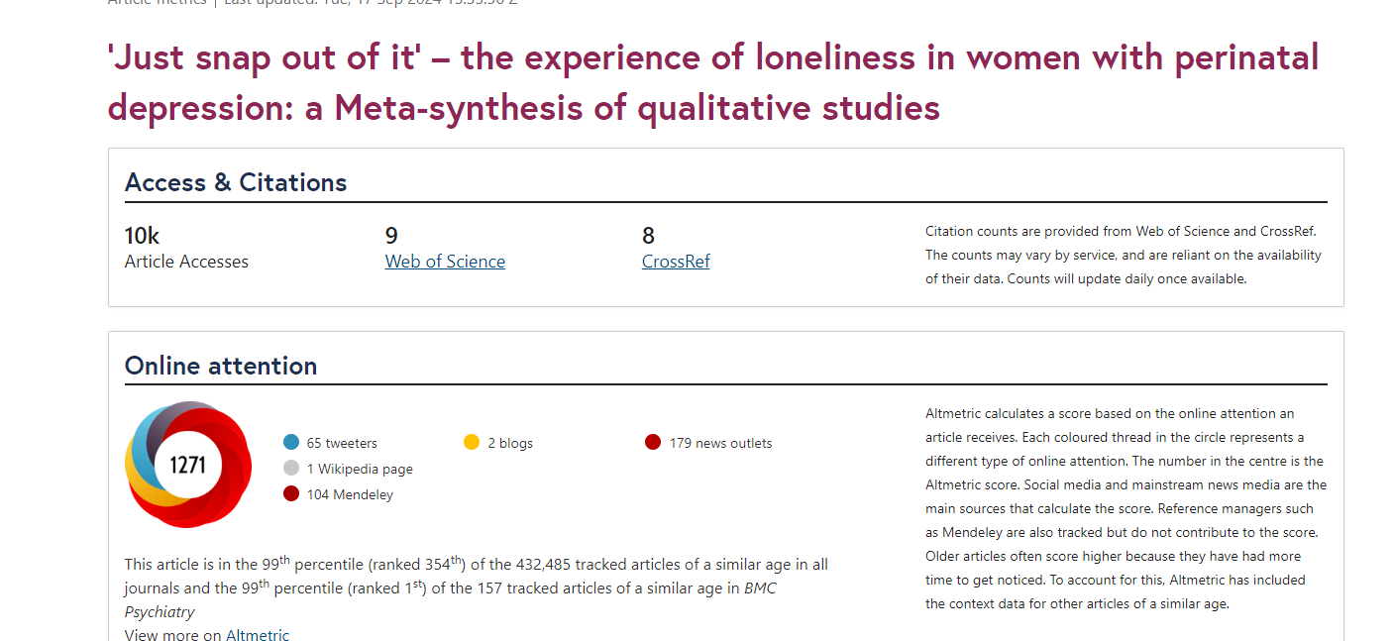
An issue that people relate to

Slide 6
Research objectives
Co-produce broad solutions for perinatal loneliness
Consider intersectional inequalities
Build a collaborative network for further work

Slide 7
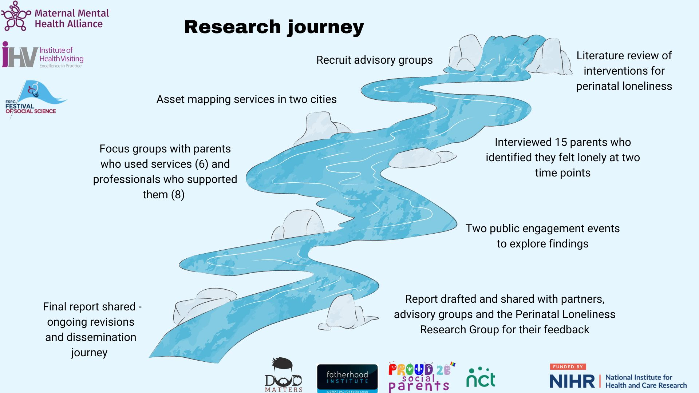
Research methods

Slide 8
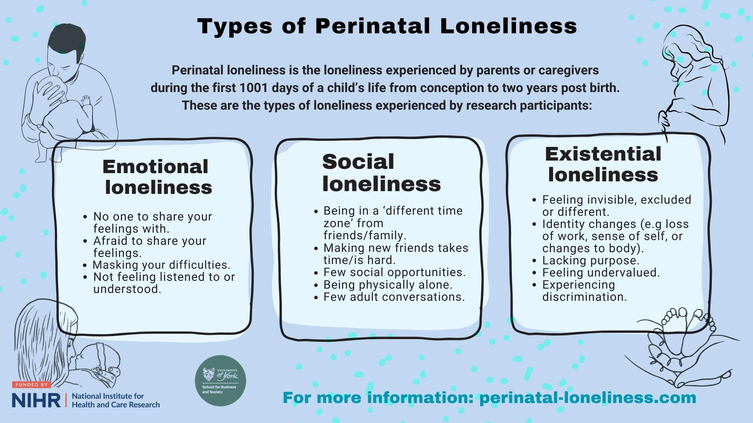

Slide 9
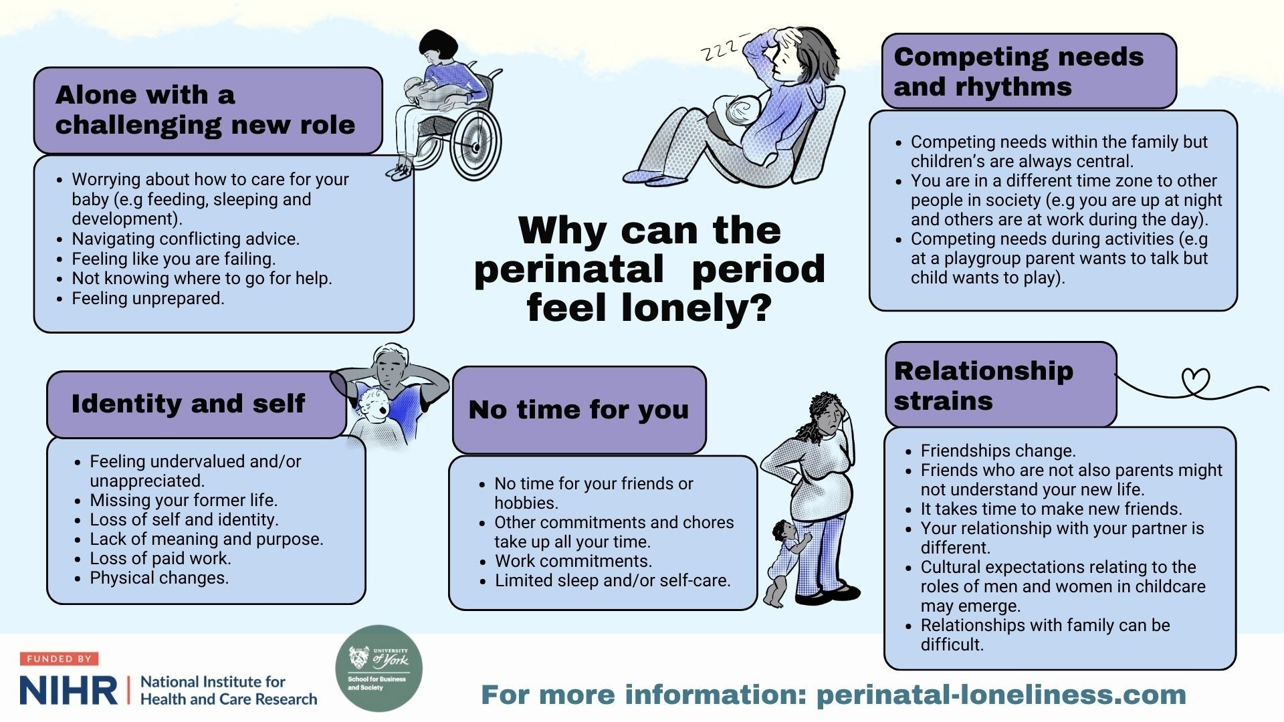

Slide 10
When did the participants feel most lonely?
Film: Lonely Times
Trigger warning: perinatal mental illness, baby loss.
Watch film here – Link to be provided in the future.
Notes:
This film shares stories based on the experiences of the 58 parents who took part in my research exploring solutions to perinatal loneliness. The stories are fictional but are based on the accounts of parents who shared the times they felt most lonely. We hope this film will raise awareness of what leads to feelings of loneliness including poverty, discrimination, unrealistic expectations put on parents, inadequate support, and being excluded. We hope that after watching this film, some people will realise they are not alone in feeling lonely.
You will now see nine animations that represent a range of experiences told through the eyes of the storyteller. Each story is separated by the image of an eye opening and closing.
After the ninth story, we will share information about our research into the solutions for loneliness, including how to find a report about what we can do to changes things. We’ll also share details of where to go for help if you need it.

Slide 11


Heart & Minds National Service Directory https://www.heartsandmindspartnership.org/parents/additional-services
Hearts & Minds Local Service Directory https://www.heartsandmindspartnership.org/parents
Samaritans https://www.samaritans.org/how-we-can-help/contact-samaritan/
You can also contact NHS 111, your GP, midwife and health visitor and ask for support.

Slide 12
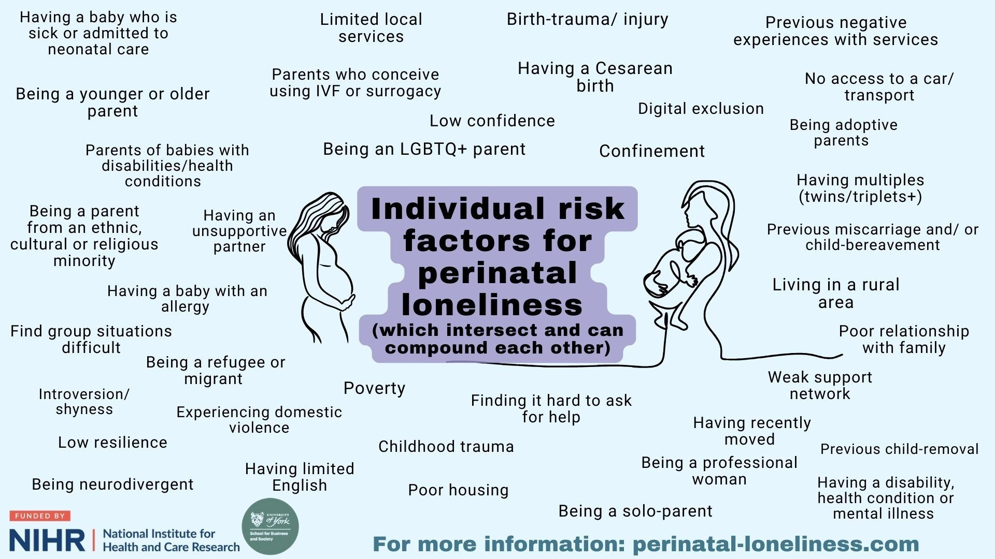
Notes:
Every single unique situation will look differently and will need a unique perspective

Slide 13
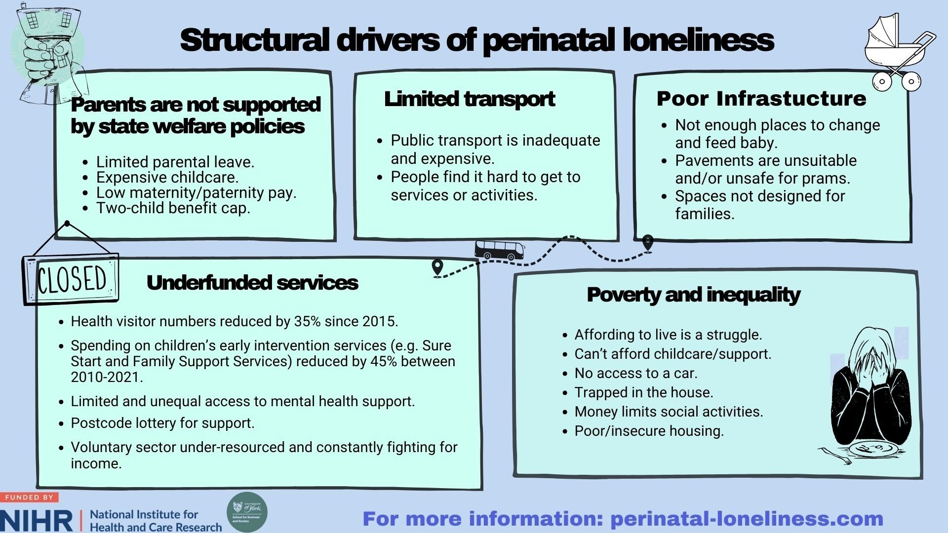

Slide 14
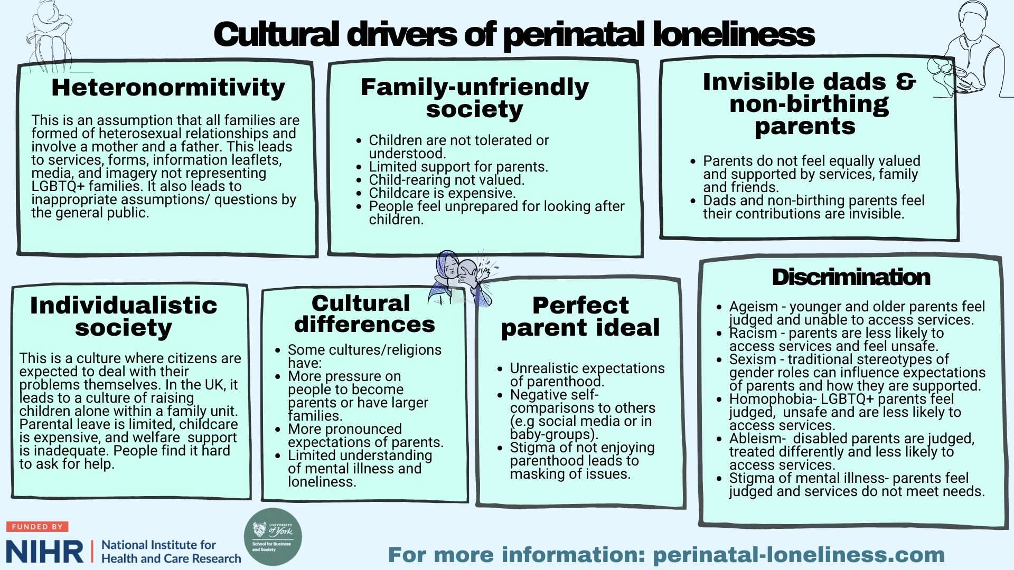

Slide 15
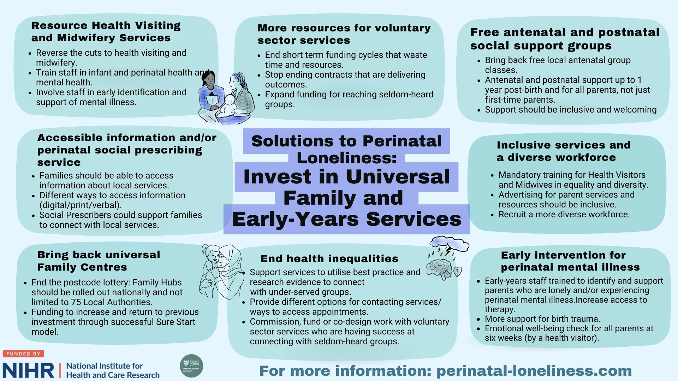
Notes:
Encourage parents to access support

Slide 16
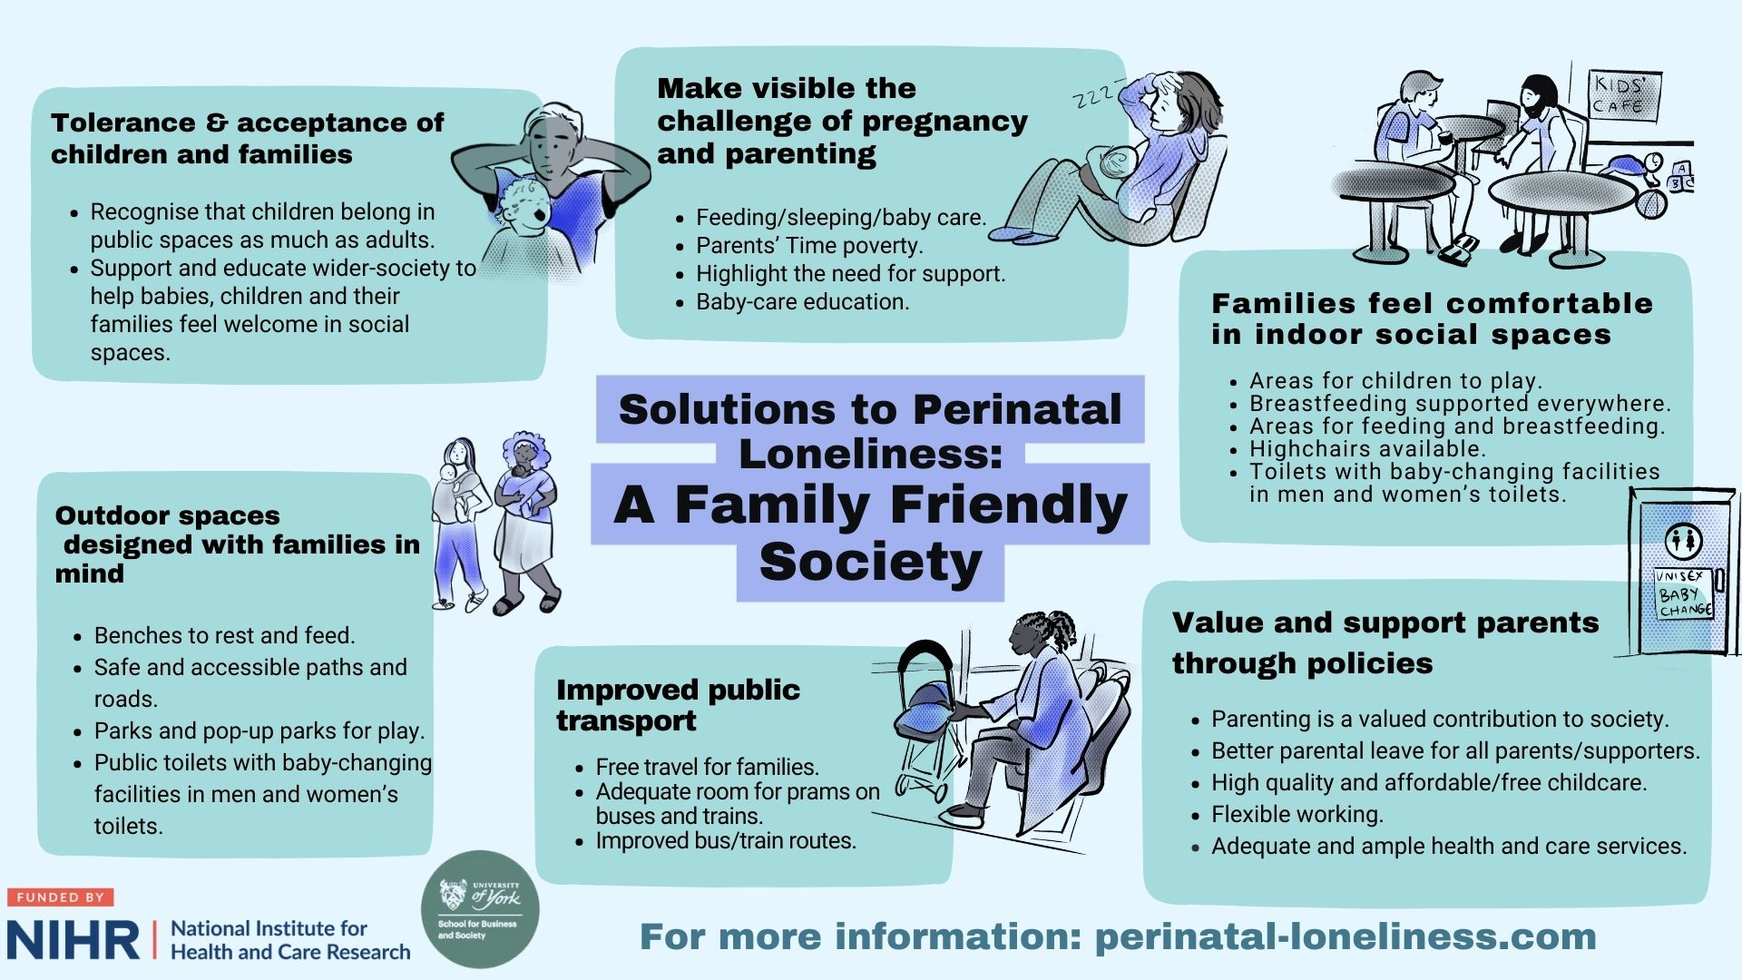
Notes:
Encourage parents to get outside and make connections

Slide 17
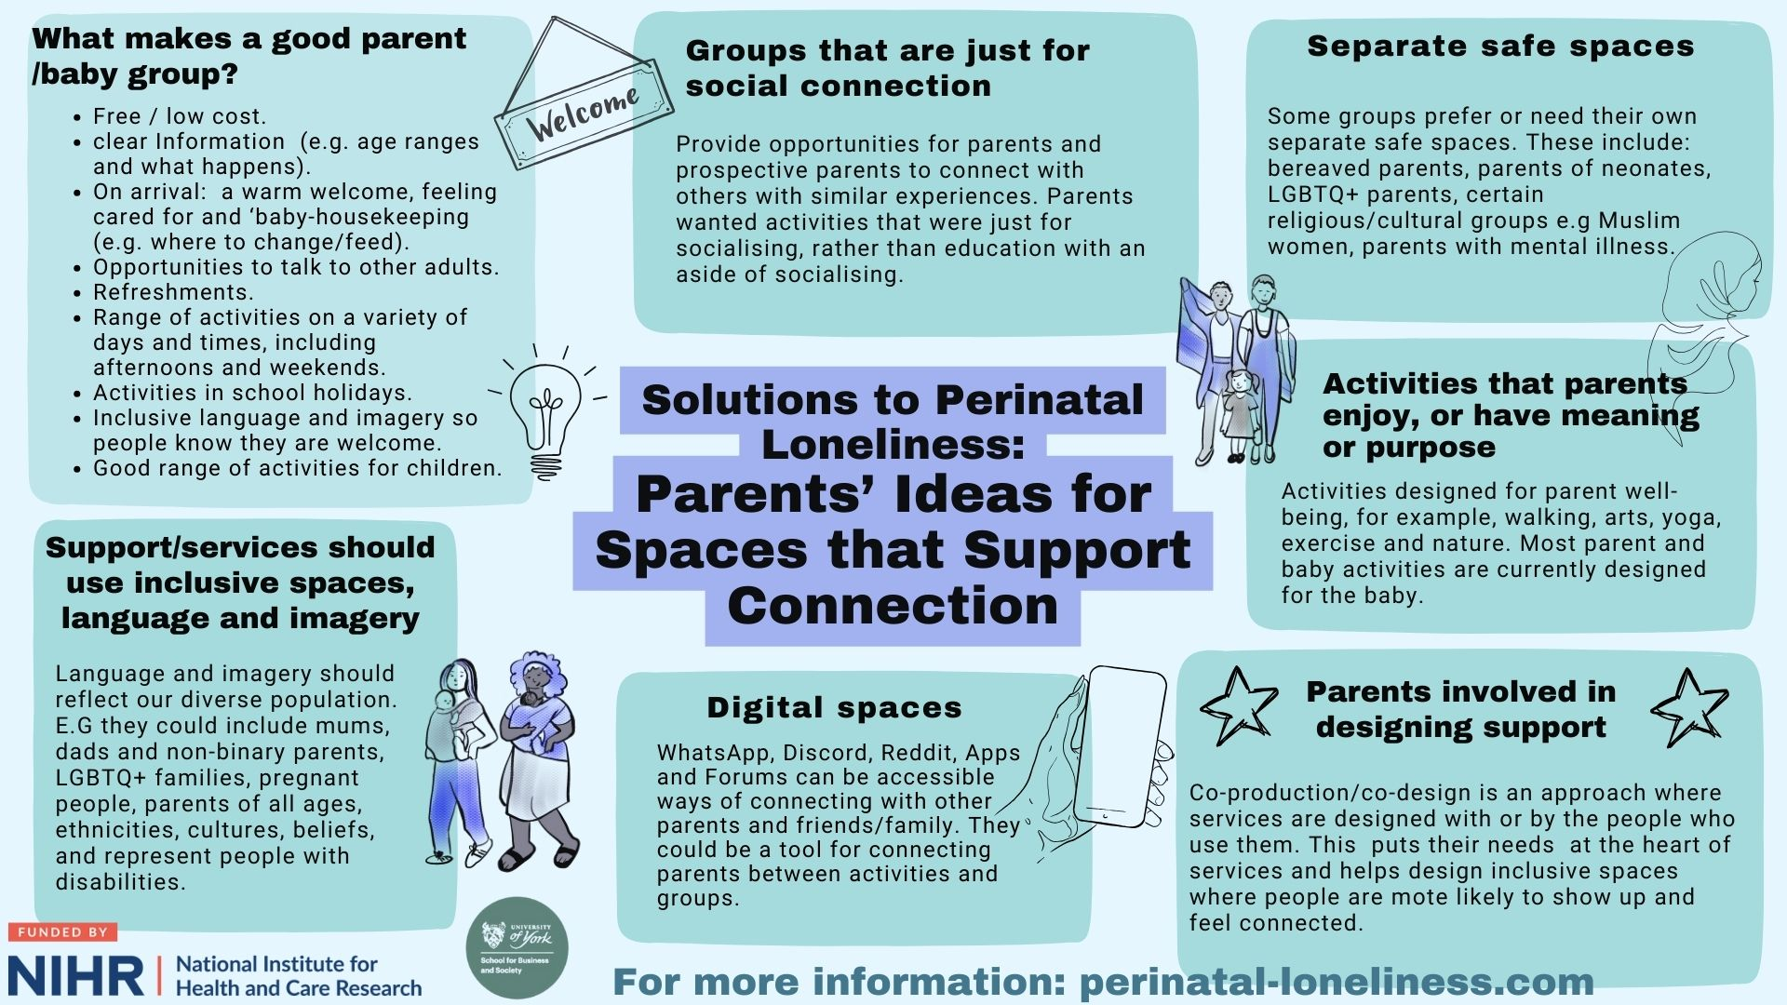

Slide 18
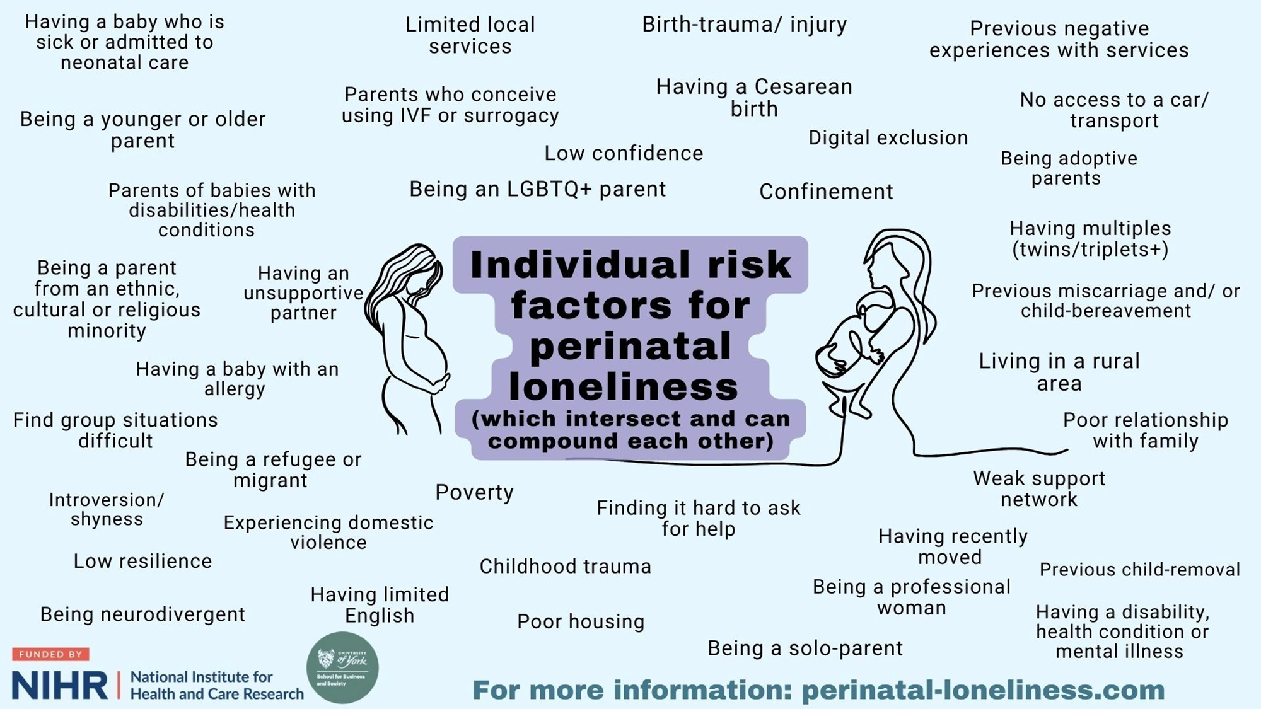
We need to know and do so much more!
A call to action!
Services & professionals implement simple strategies to increase reach and engagement
Develop and test strategies to overcome loneliness for different perinatal groups/populations
Intervention co-design, development and evaluation
Lobby policy makers e.g. more parental leave (Fatherhood Institute); more support for young mothers (MMHA & CYPHMC & Young Mothers Network); more support for voluntary sector (Hearts & Minds); invest more in Early Years and Sure Start style approaches.
Creative approaches, play & celebrating childhood

Slide 19
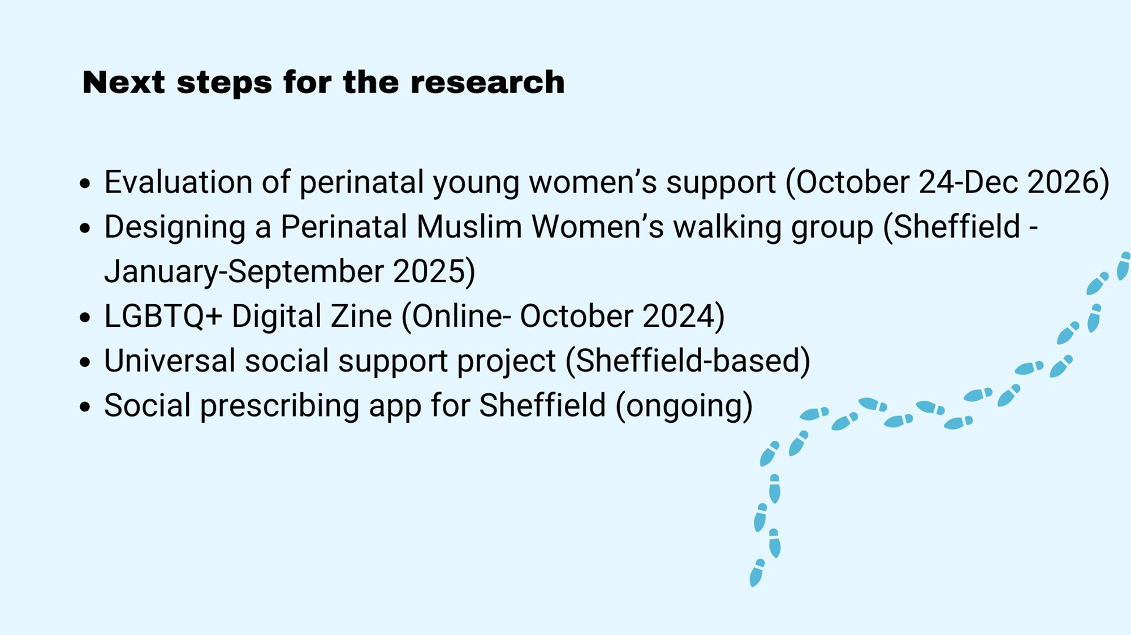
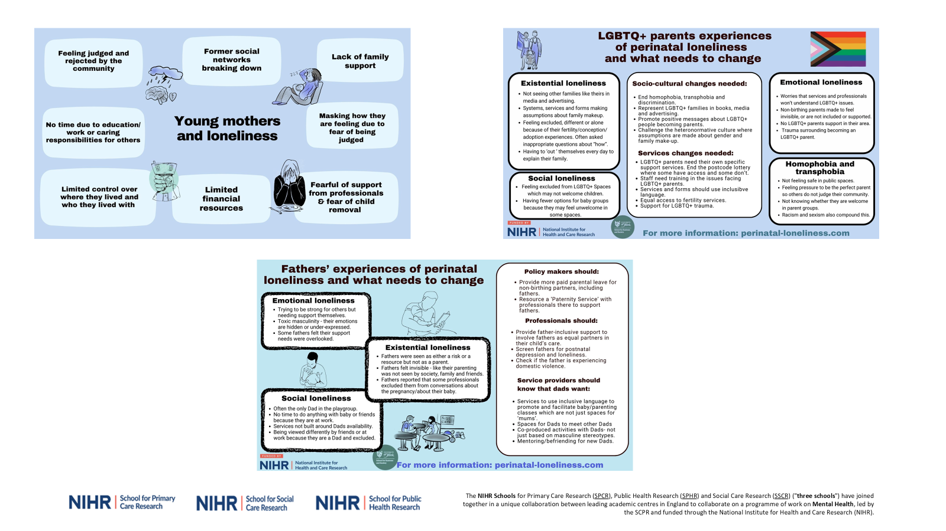

Slide 20
For more information & references ruth.naughton-doe@york.ac.uk
@ruthndwrites
@pn_loneliness www.perinatal-loneliness.com

