Slide 1
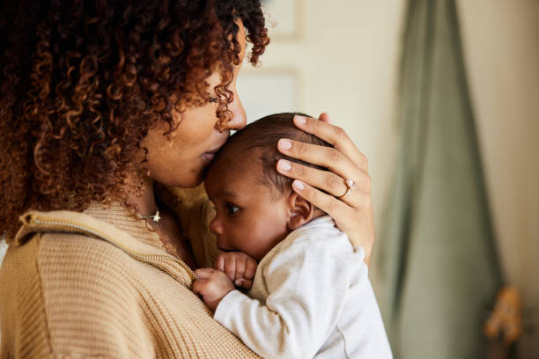
INTERSECTING IDENTITIES AND COMPOUNDED ISOLATION: EXPLORING THE EXPERIENCES OF LONELINESS AMONG SINGLE REFUGEE AND ASYLUM-SEEKING MOTHERS IN GLASGOW
PRESENTED BY
SARAH SHEMERY
PHD CANDIDATE IN SOCIAL WORK
UNIVERSITY OF EDINBURGH

Slide 2


INTRODUCTION
Loneliness is a complex, widespread public health issue, shaped by societal, economic, and political systems.
It’s not just an individual experience, but one influenced by external structures and cultural norms.
Intersectionality is key in understanding how certain identities—such as race, poverty, and trauma—expose individuals to higher risks of loneliness.
Single refugee and asylum-seeking mothers in Scotland face structural challenges that restrict their activities, movement, and future planning, amplifying loneliness and social isolation.

Slide 3

THE STUDY
  Semi-structured interviews with 15 single mothers
  Refugees or asylum seekers identifying as racialised or Black and minority ethnic
  Study done in partnership with local Glasgow charity Amma Birth Companions
  Mothers with children under the age of 5 years

Slide 4

OBJECTIVES
Explore loneliness, emotional challenges, and coping mechanisms among racialised single refugee and asylum-seeking mothers in Scotland.
Investigate systemic, organisational, and institutional factors contributing to loneliness during early parenthood, focusing on migration status, socio-economic factors, and discrimination.
Examine health and well-being perceptions of single refugee/asylum-seeking mothers and their children, emphasizing mental and emotional well-being.

Slide 5

KEY RESEARCH QUESTIONS
What are the emotional challenges and coping mechanisms for these mothers?
What systemic and institutional factors contribute to their loneliness?
How does loneliness impact their health and well-being?

Slide 6

FINDINGS
  Intersectional Isolation: Racialisation, single parenthood, finances, housing, and caregiving responsibilities intensify loneliness.
  Lack of Social Networks: Mothers struggle to build connections due to isolated placements and cultural disconnect.
  Living in Limbo: Immigration restrictions lead to uncertainty, anxiety, and depression, preventing future planning.
  Mental Health & Identity: Loneliness and “othering” impact self-esteem and identity.
  Racism & Marginalisation: Racism exacerbates feelings of isolation.
  Limited Support Access: Mothers often cannot access necessary resources.
  Employment Barriers: Restrictions prevent mothers from working or pursuing education.

Slide 7

QUOTES
Leila
“These are moms and you're a mom and you're trying to build a community that has got moms in it as well and where you [are] doing the same things. But it was tough. So I tried, I think three groups… I couldn't connect. I just felt alone. For some reason I couldn’t manage to make friends. So I ended up not going ...”
Faiza
“My daughter… I've never taken her to a soft play. It really, really pains me a lot. Not because I don't want to take out there, but because I've searched for soft plays and the lowest I can see is like £7.50 for one hour or two hours. Then I have to calculate out, I'm paying £7.50, then I have to get a snack, then we have to use the transport. Then if you want to sum up everything like that, maybe it's almost 20 pounds in a day. You have to spend almost 20 pounds in a day. If you should subtract that from your weekly allowance, which is 97 pounds, you get 77 pounds to live [on] for the week. So sometimes I just have to put myself back. It's really, really upsetting, but there's nothing I can do about it.”
Fatma
“Yes. You feel lonely because [back home], you are making your choices. You are [able to] do a lot of things by yourself, but the asylum system takes all your… [it takes] everything from you. [It’s] like you [have] a big money in your account and someday, one day, someone just comes [to] you and [takes everything] off you and leaves your bank [account] at zero. That's how the asylum system feels. It's just your... your everything. Your rights. Everything is taken away from you. You don't have anything, you don't belong. Your passport is taken, everything is taken.”
Georgia
“Yes, yes, I do [feel lonely] a lot. A lot. I do feel lonely. I even call home and cry and tell them how I really don't have anybody here. I don't have friends. So yes, I felt lonely a lot more in the UK than I did. I don't even think I felt lonely when I was in my home country, but most of the time I feel lonely.”

Slide 8

  Expand Access to Services: Improve access to social/welfare services with multilingual, trauma-informed support.
  Community Integration: Fund local programs to foster meaningful connections and reduce isolation.
  Address Financial Barriers: Increase financial support, including transport and activity funds.
  Childcare & Parenting Support: Provide affordable childcare and parenting resources.
  Employment & Education Opportunities: Remove immigration restrictions on work/education; offer training and scholarships.
  Combat Racism Through Anti-Racist Frameworks: Establish comprehensive anti-racist education and initiatives with clear reporting mechanisms.
  Promote Social Engagement: Encourage participation in inclusive community activities.
RECOMMENDATIONS

Slide 9

WHAT COMES NEXT
  Publishing a paper on the research
  Extending the research
  Creative approaches in radio broadcasting with refugee and asylum seeking mothers

Slide 10

Loneliness among young mothers in a Northern City
PhD by Florence Gaughan, Sheffield Hallam University

Slide 11
Main Aims
To understand the experiences of loneliness and isolation of some young mothers aged 18-25.
To explore how dominant discourse and expectations can affect young women’s experiences of motherhood.
To explore the perspectives on loneliness of some key stakeholders that support young mothers.

Slide 12
Research Methods
A largescale literature review about views on young parenthood and what is being done to support young mothers.
Ten in depth qualitative interviews with several charities and organisations within a Northern City that work with young mothers.
Fifteen semi-structured qualitative interviews with young mothers.
One focus group with young mothers with an arts-based focus.

Slide 13
Main Findings (so far)
Young women feel stigmatised and judged by healthcare professionals, their communities, and sometimes by family and friends
Pressure to appear they are coping because of expectations based on their age, despite high likelihood of financial/housing/social/emotional issues
Friends often disappear when a young woman becomes pregnant
Young mothers often have young parents themselves often meaning difficulty in gaining support from grandparents
Young women use social media as a key support mechanism in their parenting and for self-esteem
Charities see loneliness as a real problem for young mothers but loneliness is seldom a main focus of work (although it is discussed informally)

Slide 14
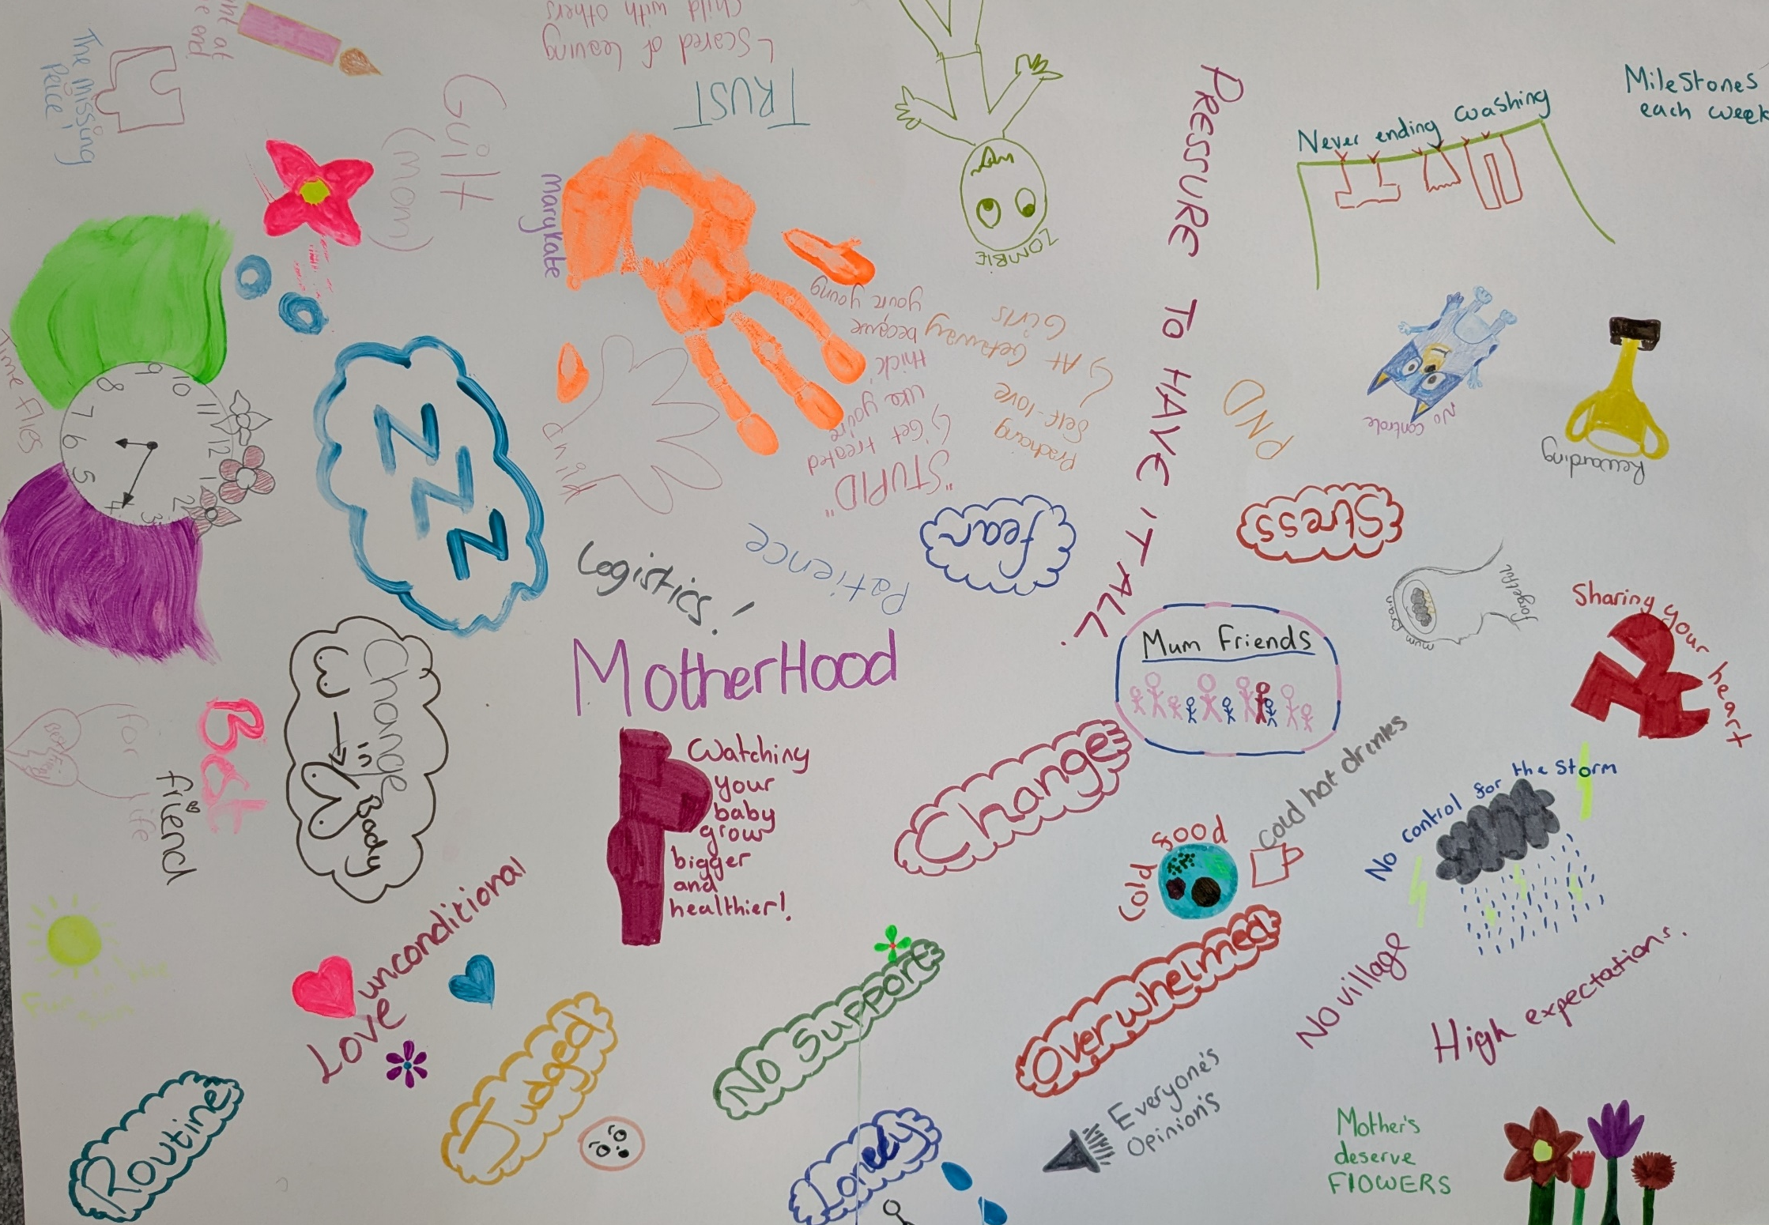
Art Based
Method
Results

Slide 15
How Do We Reduce Loneliness Among Young Mothers in the First 1001 Days?
Bring young women together – by helping to foster friendships with other young mothers in non-judgemental and therapeutic spaces
Promote loneliness as a key issue to charities, organisations and professionals that work with young mothers
Tackle the issues early on to help de-stigmatise loneliness and young parenthood – in pregnancy or even before. Eg during sex education in school or via social media promotions

Slide 16

Maternal Mental Health and Child Wellbeing of Black African Immigrant Mothers in the UK
Funmilayo Dolapo Fabiyi
Researcher
Dr Zoe Darwin, Dr Rajeeb Sah, Dr Amanda Firth.
Supervisors
Tackling Parental Loneliness in the First 1001 Days: Online Conference
18th September 2024

Slide 17
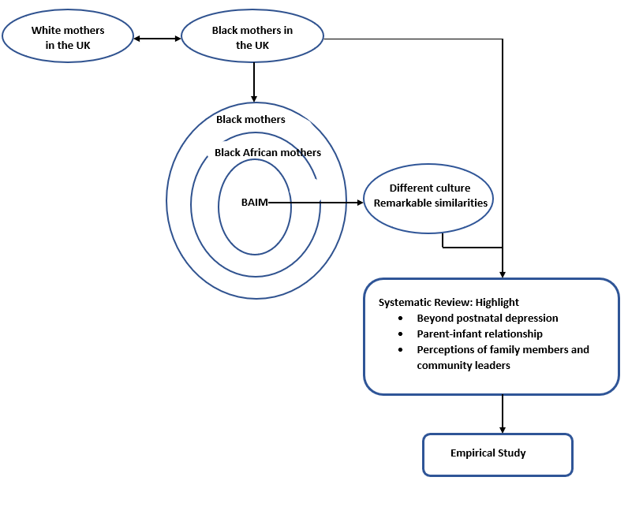
Introduction
BAIM=Black African Immigrant Mothers

Slide 18
Systematic Review
A systematic review was conducted on “The Perinatal Mental Health Experiences of Black Immigrant Mothers in the UK” to identify studies and gaps in research informing the development of the proposed empirical research.
Aim
To describe and understand the perinatal mental health needs and experiences of Black Immigrant Mothers in the UK
Objectives
To explore the perinatal mental health needs and experiences of Black Immigrant Mothers in the UK.
To explore the available support for Black Immigrant Mothers in their perinatal period.
To explore the views and experiences of Black Immigrant Mothers on the support they receive regarding their mental health.

Slide 19
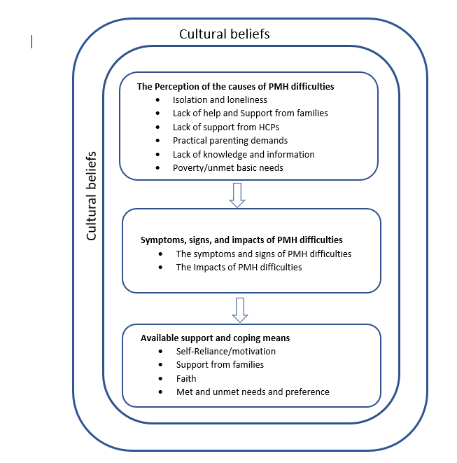
Summary of the Findings

Slide 20
Perceived Causes of Loneliness
Significant concern over feeling isolated and lonely in the UK
Comparison between their collectivist culture and the UK being individualistic.
Separation from the wider communities due to perceived cultural stigma.
Lack of support and the distance from their relatives

Slide 21
Recommendations
Seeking other mothers in their communities for information, reassurance, and support.
Access to their family members in their home country by making a phone.
Faith/religion has been a crucial motivating factor that has sustained them through challenging time.
A community that provides support like what they receive in Africa.
Provision of culturally sensitive health care services.
Access to information.

Slide 22
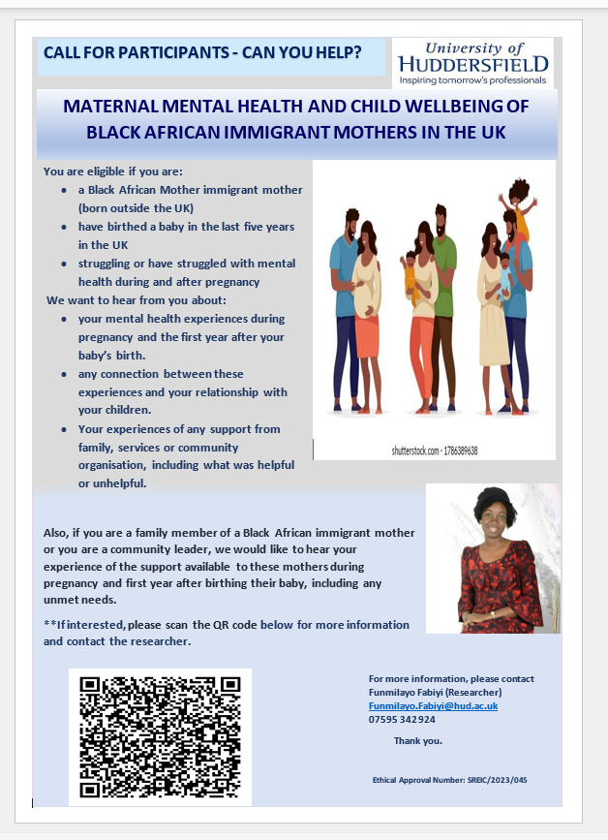

Slide 23
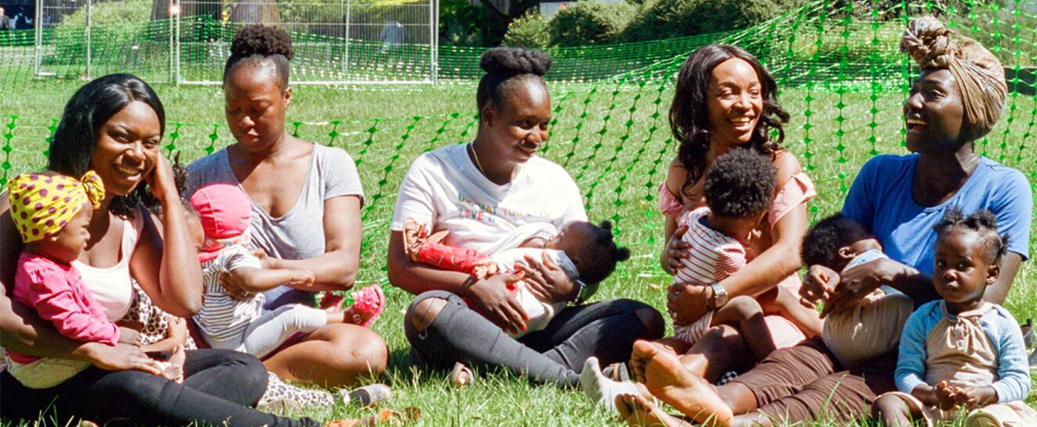
Thank You
Blackhistorymonth.org.uk

Slide 24
Thank You

