Slide 1
The Experience of Loneliness in
Women with Perinatal Depression
Perinatal Loneliness Conference: Wednesday 18th September 2024
Dr Katherine Adlington
Academic Clinical Fellow in Translational Psychiatry, QMUL
Higher Trainee in General Adult Psychiatry (ST5), East London NHS Foundation Trust

Slide 2
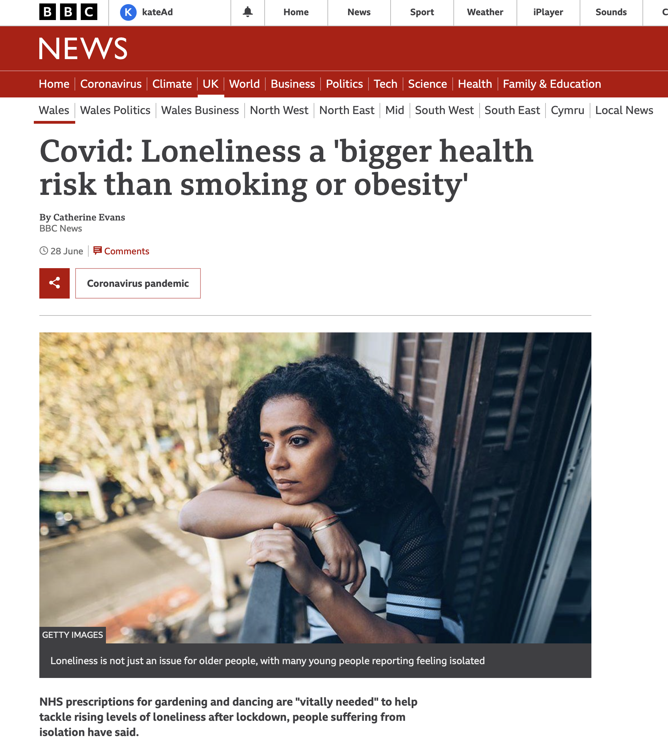

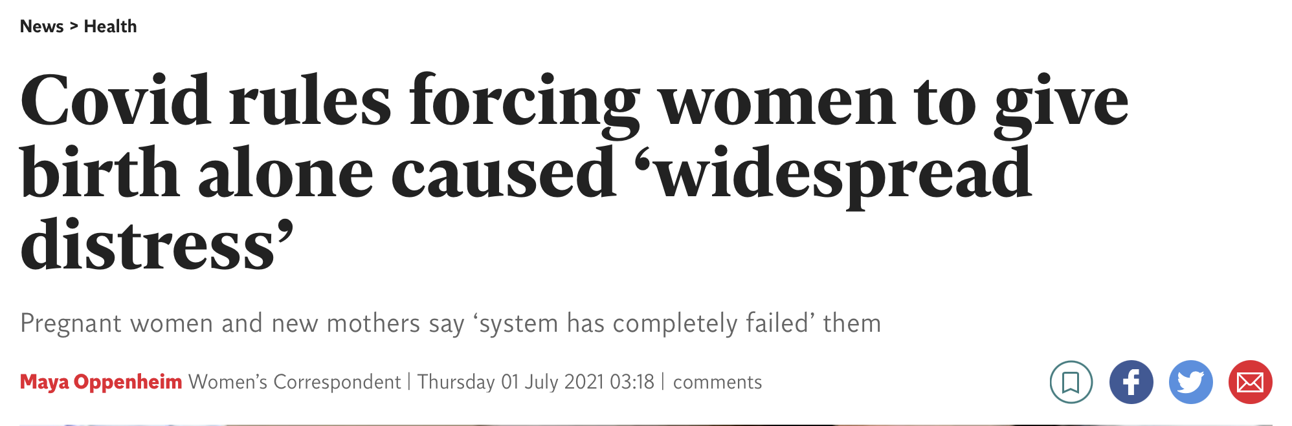
Perinatal depression & loneliness
Vulnerability to perinatal loneliness
Vulnerability to perinatal depression
  1 in 6 antenatal¹ & 1 in 5 postnatal²
  Impact on quality of life, risk of self-harm & relationship with baby^{3,4,5}
Unique impact of pandemic
  Increased levels of perinatal anxiety & depression⁹
  53% of perinatal women experienced high levels of loneliness in the pandemic¹⁰
Notes:
Evidence that relationships1 in 6 = antenatal depression¹ & 1 in 5 = postnatal depression²
Affects quality of life & close relationships
Increases risk of self harm & death by suicide
Impairs mother-infant interactions & child’s cognitive & emotional development
change

Slide 3
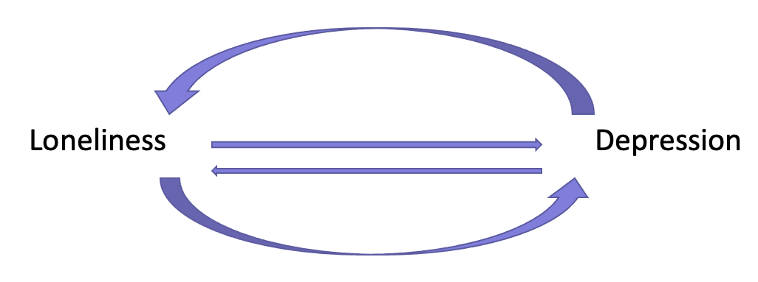
Research into loneliness & depression
Loneliness shown to have bidirectional relationship with depression
  Depression increases risk of loneliness ten-fold¹²
  Loneliness increases risk of depression & worsens symptoms in those already depressed¹³⁻¹⁴
Mechanisms for this complex, reciprocal inter-relationship are unclear
Social support known to be a risk factor for perinatal depression & increasing evidence that loneliness is too¹⁵⁻¹⁶
Qualitative studies broadly exploring perinatal depression find loneliness experiences are common¹⁷⁻¹⁹:
“enveloped in unbearable loneliness”
“a deep sense of loneliness”
“detached and removed from those around them”
Notes:
Very few qualitative studies focussed exclusively on loneliness & no existing overview of qualitative research on this topic
Loneliness has been shown to have substantial effects on mental and physical health and the relationships tend to be bidirectional [19]. Most research exploring the interaction between loneliness and mental health has focused on depression. Cross-sectional studies show that people with depression are 10 times more likely to feel lonely than the general population [20]. Longitudi- nal studies have shown that loneliness increases the risk of depression [21] and worsens depressive symptoms in those already depressed [22]. The mechanisms behind this complex, reciprocal inter-relationship between loneliness and depression are unclear [23]. Theoreti- cal models propose that loneliness has biological, social and cognitive consequences that can increase the risk of depression [24].

Slide 4
Aims
Undertake a qualitative meta-synthesis of research exploring loneliness in women with perinatal depression to:
  Provide an overview of the available international literature
  Identify major overarching themes across these studies
Primary research question: | What are the experiences of loneliness for women with perinatal depression?
Secondary research question: | What helps and what makes loneliness worse for women with perinatal depression?
Notes:
Very few qualitative studies focussed exclusively on loneliness & no existing overview of qualitative research on this topic

Slide 5
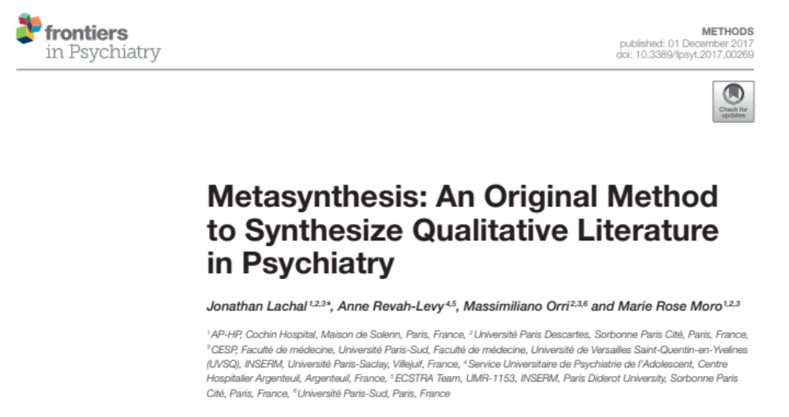
Methods
Meta-synthesis of qualitative studies (Lachal et al methodology)²⁰
Notes:
Patient and Public Involvement in this study
Patient Advisory Group of women with lived experience of perinatal mental illness
Feedback on protocol, including shaping the initial research question
1.5 hour online meeting during analysis stage – women drew on own experiences of loneliness in the perinatal period and gave feedback on initial findings and emerging themes –
Helped to shape & validate themes, identify gaps in the data

Slide 6
Methods
Pre-planned protocol on Prospero
1st researcher
Systematic search
Screening
Extraction
2nd researcher assessed 10% of eligible papers at each stage & reviewed framework of descriptive themes
Quality appraisal
Data analysis
Any disagreements discussed with wider research team
Output = Narrative Synthesis
Notes:
There is a complex inter-relationship between loneliness & depression

Slide 7
Results
9592 publications identified
2764 duplicates excluded
6828 relevant publications title and abstract screened
6502 excluded based on irrelevant titles and abstracts/ inappropriate study design
326 publications full text reviewed
Total 303 excluded on grounds of eligibility:
70 excluded as < 50% of paper was discussing loneliness or a related social construct
61 excluded as it was not a qualitative study
52 excluded as the study did not mention loneliness or a related social construct
46 excluded as participants were not discussing experiences from the perinatal period
26 excluded due to insufficient qualitative data
25 excluded as participants did not have a perinatal mental health disorder
16 excluded due to participants having other perinatal mental health disorders (psychosis, anxiety, PTSD)
2 excluded due to duplication of studies
4 excluded due to no English language version
1 excluded due to substance misuse
23 papers for qualitative synthesis
Forwards and backwards citation tracking of 23 papers
4 additional relevant publications identified
Total of 27 publications included in final qualitative synthesis
Refs for included papers available on request
Notes:
There is a complex inter-relationship between loneliness & depression

Slide 8
Results
  Published between 1992 and 2021
  All high or upper-middle income countries
  Overall sample size > 537 women, average age 28 years
  Majority postnatal depression (n=21) & self-reported depression
  Only 1 paper had an explicit research aim to explore the experience of loneliness
  11 papers exclusively explored the experiences of women from marginalised groups
  Mean quality score = 7.4 out of 10
Total of 27 publications included in final qualitative synthesis
Notes:
There is a complex inter-relationship between loneliness & depression

Slide 9
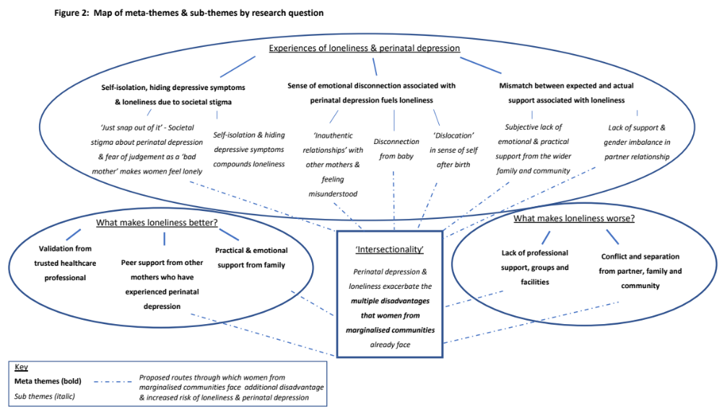
Results
Notes:
There is a complex inter-relationship between loneliness & depression

Slide 10
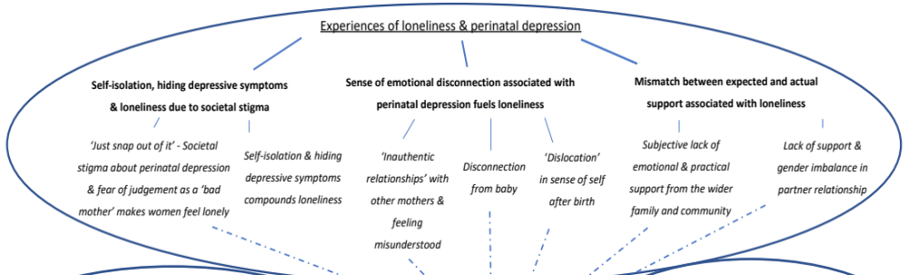
Results
Research Q 1: Experiences of loneliness & perinatal depression
‘”Just snap out of it. You have a husband who loves you and a beautiful healthy baby. What more do you want!”’
‘I didn’t want to talk with anybody about it, I always had to pretend that I was doing just great … I thought that wasn’t normal, that I was a bad mom who felt that way’
‘what comes out of your mouth is, ‘ No, I don’t need any help ’ even though inside, you’re screaming, and saying, ‘Yes, for God’s sake, help me.”
Notes:
There is a complex inter-relationship between loneliness & depression
‘what comes out of your mouth is, ‘ No, I don’t need any help ’ even though inside, you’re screaming, and saying, ‘Yes, for God’s sake, help me.”
Hiding symptoms could also be due to an increased fear of social services involvement or even potential child removal due to their depression (‘I just lied through my teeth because I thought, “What are they going to do if they find out I can’t be a good mom?”’

Slide 11
Results
Research Q 1: Experiences of loneliness & perinatal depression
‘Although I had a lot of support from a lot of people, which should have made me ecstatic, I couldn’t actually connect with it’
‘I remember going to [a postnatal group] . . . and I thought... “You shouldn’t be here.” I just felt everyone else seemed so happy and so really pleased. So I didn’t go there again.’
‘For some mothers, a baby’s need to be close to them could feel uncomfortable, even threatening, yet a lack of closeness also resulted in high levels of distress. As Emma explained: “[My baby] used to have to sleep on my chest and, because I didn’t want him near me, it was really hard having him on my chest. So he used to just lay there and scream in pain and I used to just sit in another part of the room and just cry.”’
Notes:
There is a complex inter-relationship between loneliness & depression
‘what comes out of your mouth is, ‘ No, I don’t need any help ’ even though inside, you’re screaming, and saying, ‘Yes, for God’s sake, help me.”
Hiding symptoms could also be due to an increased fear of social services involvement or even potential child removal due to their depression (‘I just lied through my teeth because I thought, “What are they going to do if they find out I can’t be a good mom?”’

Slide 12
Results
Research Q 1: Experiences of loneliness & perinatal depression
‘[W]hen I was pregnant I had that mindset we’re gonna have a precious family, we are gonna stay here and raise them, you’re going to help me. But . . . it’s always like I gotta carry the burden by myself, so that’s pretty stressful . . . everything is pushed on me and I never get a break‘
‘While Lottie said her partner “stopped contact . . . and decided to move on to a new relationship”, she was left struggling to look after their baby alone. Lottie felt that parenthood had little impact on her partner’s life or social status, whereas for her the impact was profound’
Notes:
There is a complex inter-relationship between loneliness & depression
‘what comes out of your mouth is, ‘ No, I don’t need any help ’ even though inside, you’re screaming, and saying, ‘Yes, for God’s sake, help me.”
Hiding symptoms could also be due to an increased fear of social services involvement or even potential child removal due to their depression (‘I just lied through my teeth because I thought, “What are they going to do if they find out I can’t be a good mom?”’

Slide 13
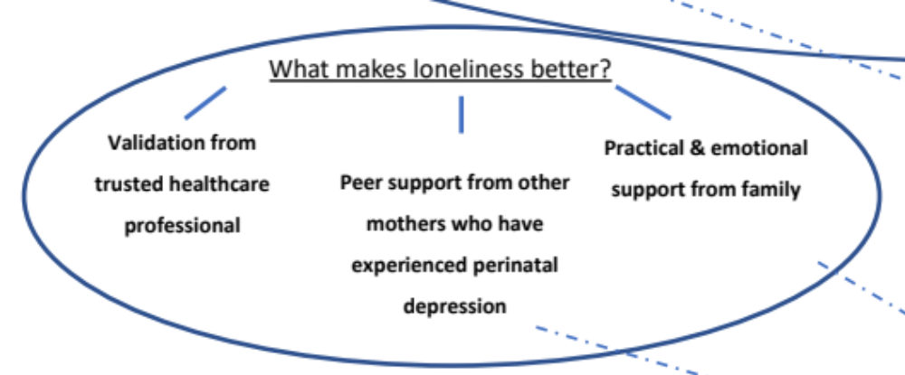
Results
Research Q 2: What makes loneliness better or worse for women with perinatal depression?
‘Lauren, for example, described how it was her stay on an MBU [psychiatric mother and baby unit] that ﬁnally enabled her to bond with her baby because she felt cared for herself in a safe place that was “kind of like family”.’
‘Groups are a safe place to say ‘This isn’t the greatest time of my life ’ , and getting some support that you are a good mom, and that your baby does feel loved, even though you’re not, like, jumping up and down for joy, and that it will get better.’
‘‘When I’m depressed, my mom just – she basically cries it out with me. And she just tells me, “Don’t worry about it. It’s just one day, just today. It’ll be better tomorrow,” … I know I can always go to my mom and I can always tell her something and she’s not going to judge me.
Notes:
There is a complex inter-relationship between loneliness & depression

Slide 14
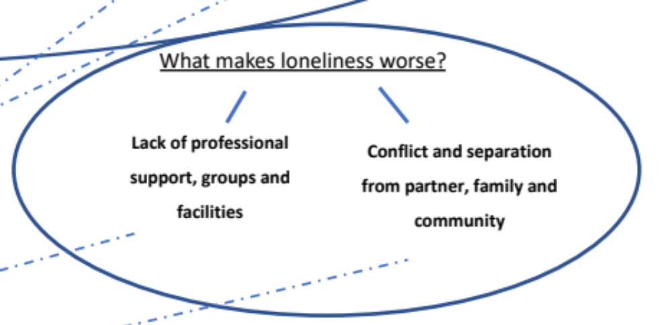
Results
Research Q 2: What makes loneliness better or worse for women with perinatal depression?
’My interview with [professional] …. I think it made me spiral downhill further, because she told me that I was just adjusting to my new job as a mom and was feeling isolated, and I should go back to breastfeeding and enjoy the breastfeeding experience!? And didn’t validate that I’d had anxiety … . So I spiraled downhill because the next day, I was feeling bad again’
Notes:
There is a complex inter-relationship between loneliness & depression

Slide 15
Results
Research Q 2: What makes loneliness better or worse for women with perinatal depression?
‘My husband left me in pregnancy, and I have no-body, my family are in India. I can’t speak English properly, and I can’t read English to ﬁll out forms. I don’t know what to do, I need help, don’t know where to go, or who to turn to’
‘Most participants expressed that being a newly immigrated mother without the familiar, preexisting support networks could predispose women to PPD. Women felt that they were vulnerable because of the lack of family support after childbirth. For Anna, being connected was the norm back home: “The families are so big and so supportive. We’re always in touch . . . always gathering around someone.”’
Notes:
There is a complex inter-relationship between loneliness & depression

Slide 16
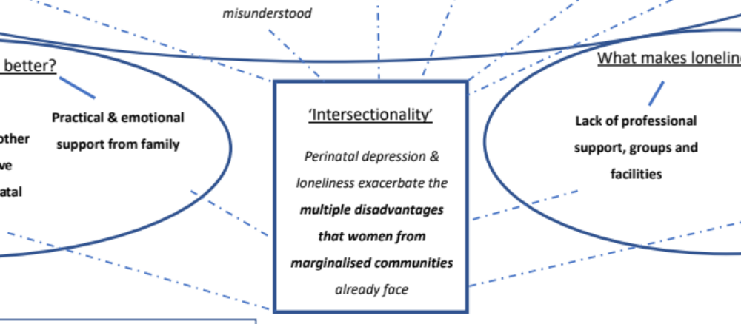
Results
‘You feel like you're alone in the world, there is not many people to care for me, I don't have family here. I felt lonely’
Notes:
Given the large number of studies in disadvantaged groups, we found that perinatal depression and loneliness seemed to exacerbate the multiple disadvantages that women from marginalised communities already face. For example, the stigma and social isolation that mothers who were immigrants already experienced was made worse both by depression and new motherhood.

Slide 17
Discussion
Results reflect findings from existing theory & research, e.g.:
  Both ‘emotional’ and ‘social’ loneliness featured in women’s accounts²¹
  Loneliness can be normative during transitions but these women describe a more complex & pathological sense of ‘loss’ of identity linked to depression
  Loneliness & perinatal depression seemed to be interlinked & ’mutually reinforcing’²²
  Loneliness seemed to be a mediator between mental health-related stigma & perinatal depression²⁴
Results also provide some novel insights, e.g.:
  Importance of healthcare professionals & interventions in alleviating loneliness
  Support groups can exacerbate feelings of loneliness & inauthenticity (emphasised by PAG)
  Perinatal depression exacerbated existing inequalities for marginalised women leading to retreat from people or places they might find connection
Notes:
Emotional loneliness – 'the absence of meaningful relationships'Social loneliness – a 'perceived deficit in the quality of social connections' Existential loneliness – a 'feeling of fundamental separateness from others and the wider world'

Slide 18
Strengths & Limitations
  Strengths
  Novel question
  Important clinical implications
  Robust, systematic methodology
  Good patient involvement
  Good attempts to address reflexivity
  Limitations
  Poor attempts to address reflexivity in included studies
  Lack of research in diverse cultural settings
  Issues with diagnostic validity
  Overlap between loneliness & other related but conceptually distinct terms
Notes:
There is a complex inter-relationship between loneliness & depression

Slide 19
Clinical recommendations to reduce loneliness in first 1001 days
  Clinicians & other professionals should ask about feelings of loneliness & access to emotional & practical support – such as with childcare
  Validate experiences of depression & reassure mothers they are ‘good enough’
  Fund accessible support groups specifically for women with perinatal depression
  Focus on disadvantaged groups as there is a double burden for them
    Do you offer culturally appropriate support without language barriers?
Notes:
Results raise awareness of the experience of loneliness for women with perinatal depression & their families – particularly given unique social isolation of pandemic
Messages for healthcare professionals & commissioners:

Slide 20
Future opportunities
More qualitative studies with specific research questions about loneliness & perinatal depression
More research in low- and middle-income settings and in different cultural contexts
Explore social & psychological interventions targeting loneliness in perinatal depression (is there also improvement in depressive symptoms?)
Explore the role of loneliness in other perinatal mental health conditions
Notes:
What is next/discuss opportunities to collaborate/provide links to outputs? (if anything).

Slide 21
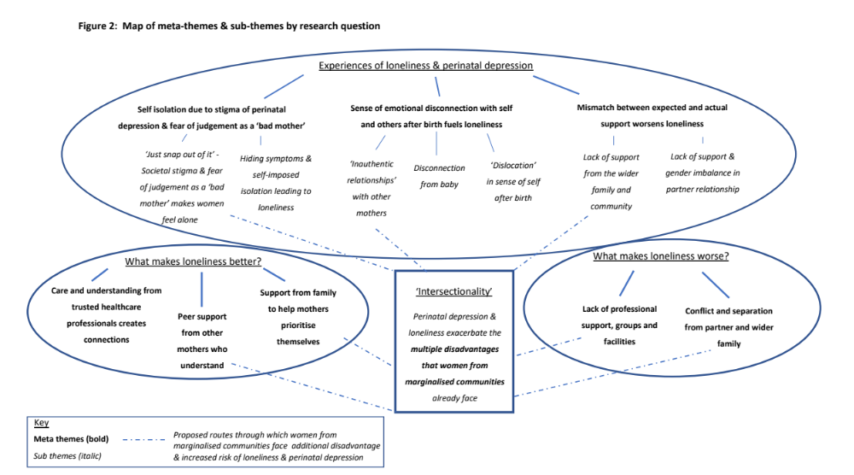
Conclusions
This qualitative meta-synthesis of 27 studies provides evidence of the centrality of loneliness in women’s experiences of perinatal depression, particularly those from disadvantaged communities.
Validation and support from healthcare professionals & support groups for women with perinatal depression could help women feel less lonely at this time.
More research is required to understand the interaction between perinatal depression and loneliness in different cultural contexts and whether interventions to reduce perinatal loneliness could also improve depressive symptoms.
Notes:
There is a complex inter-relationship between loneliness & depression

Slide 22
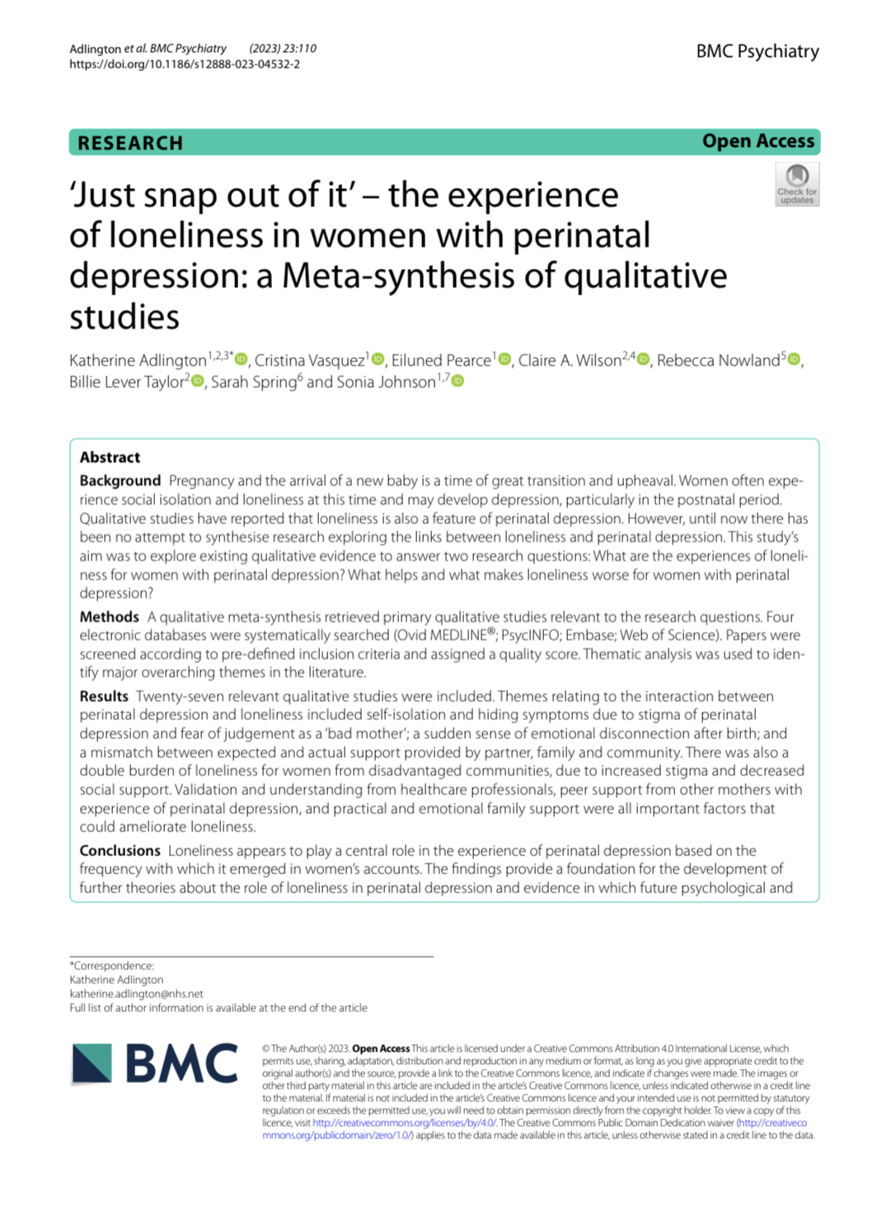
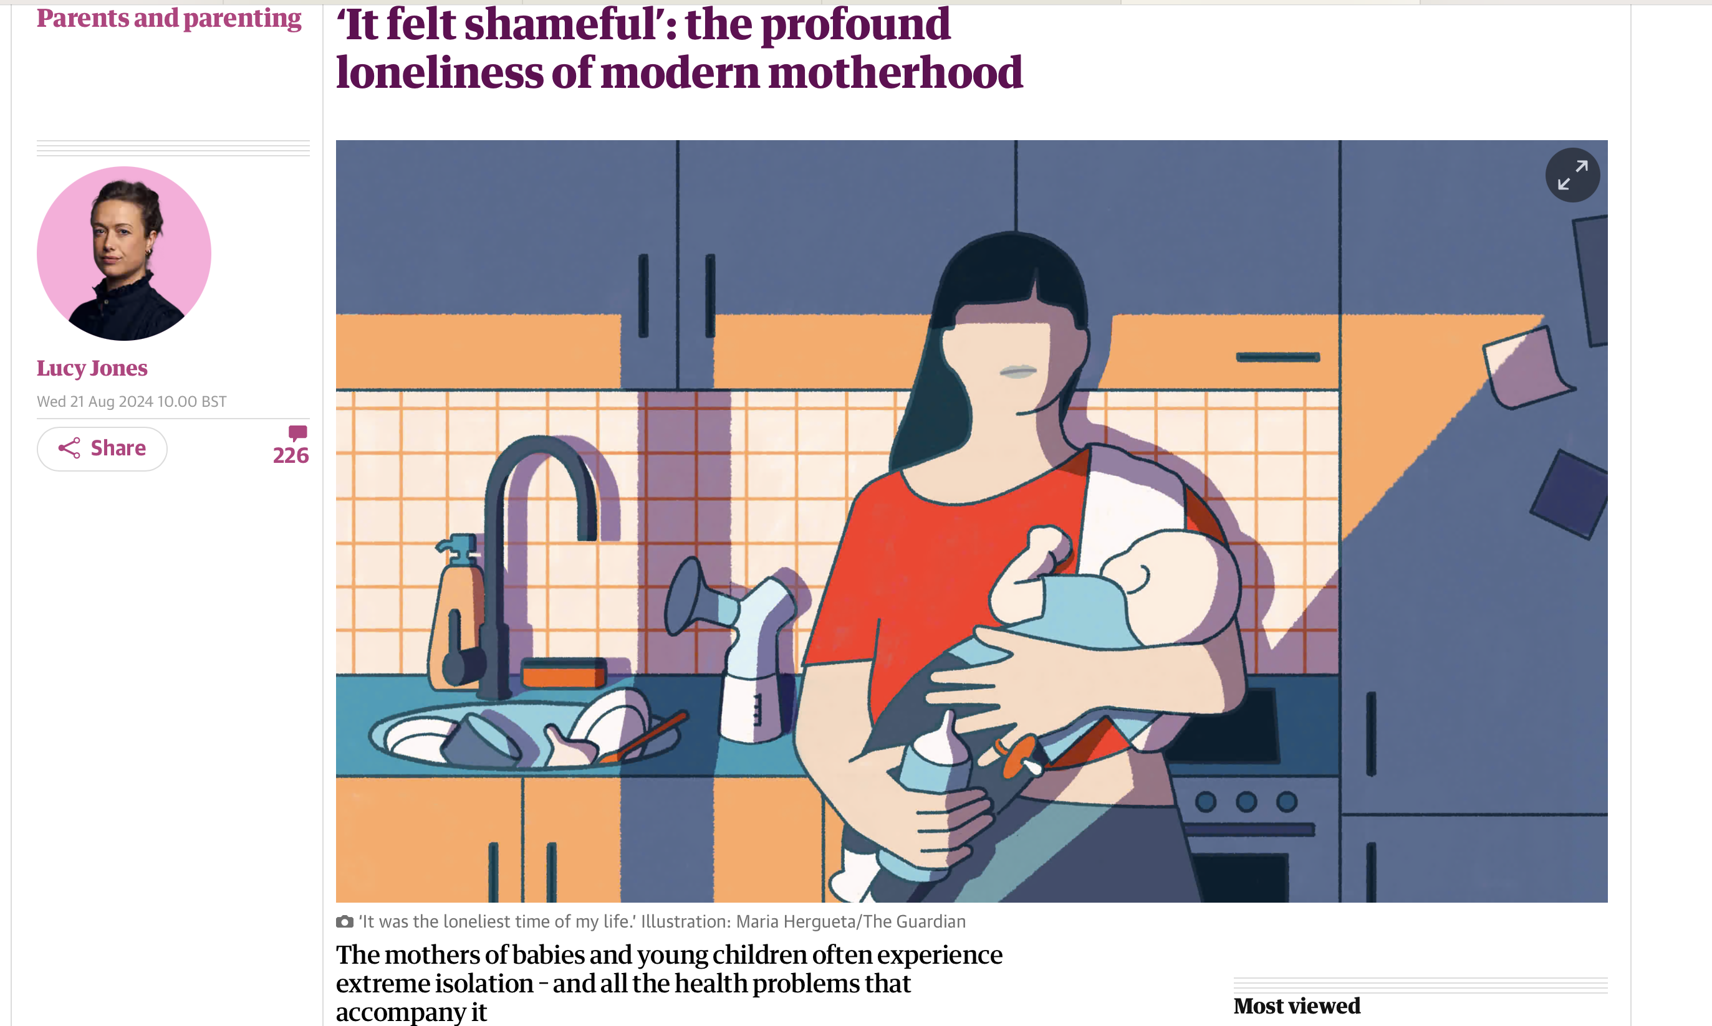
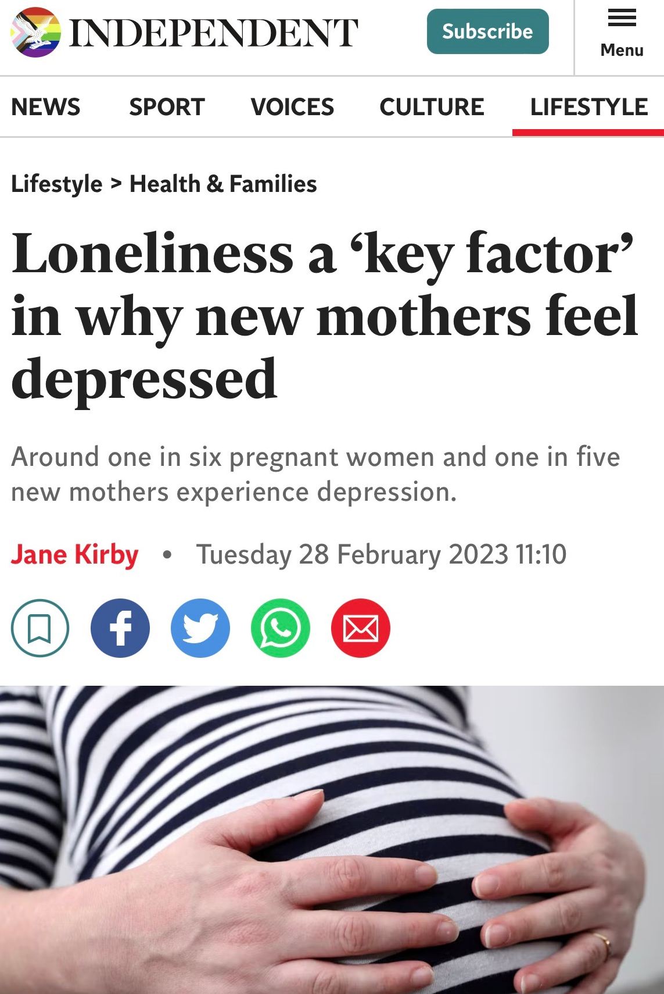
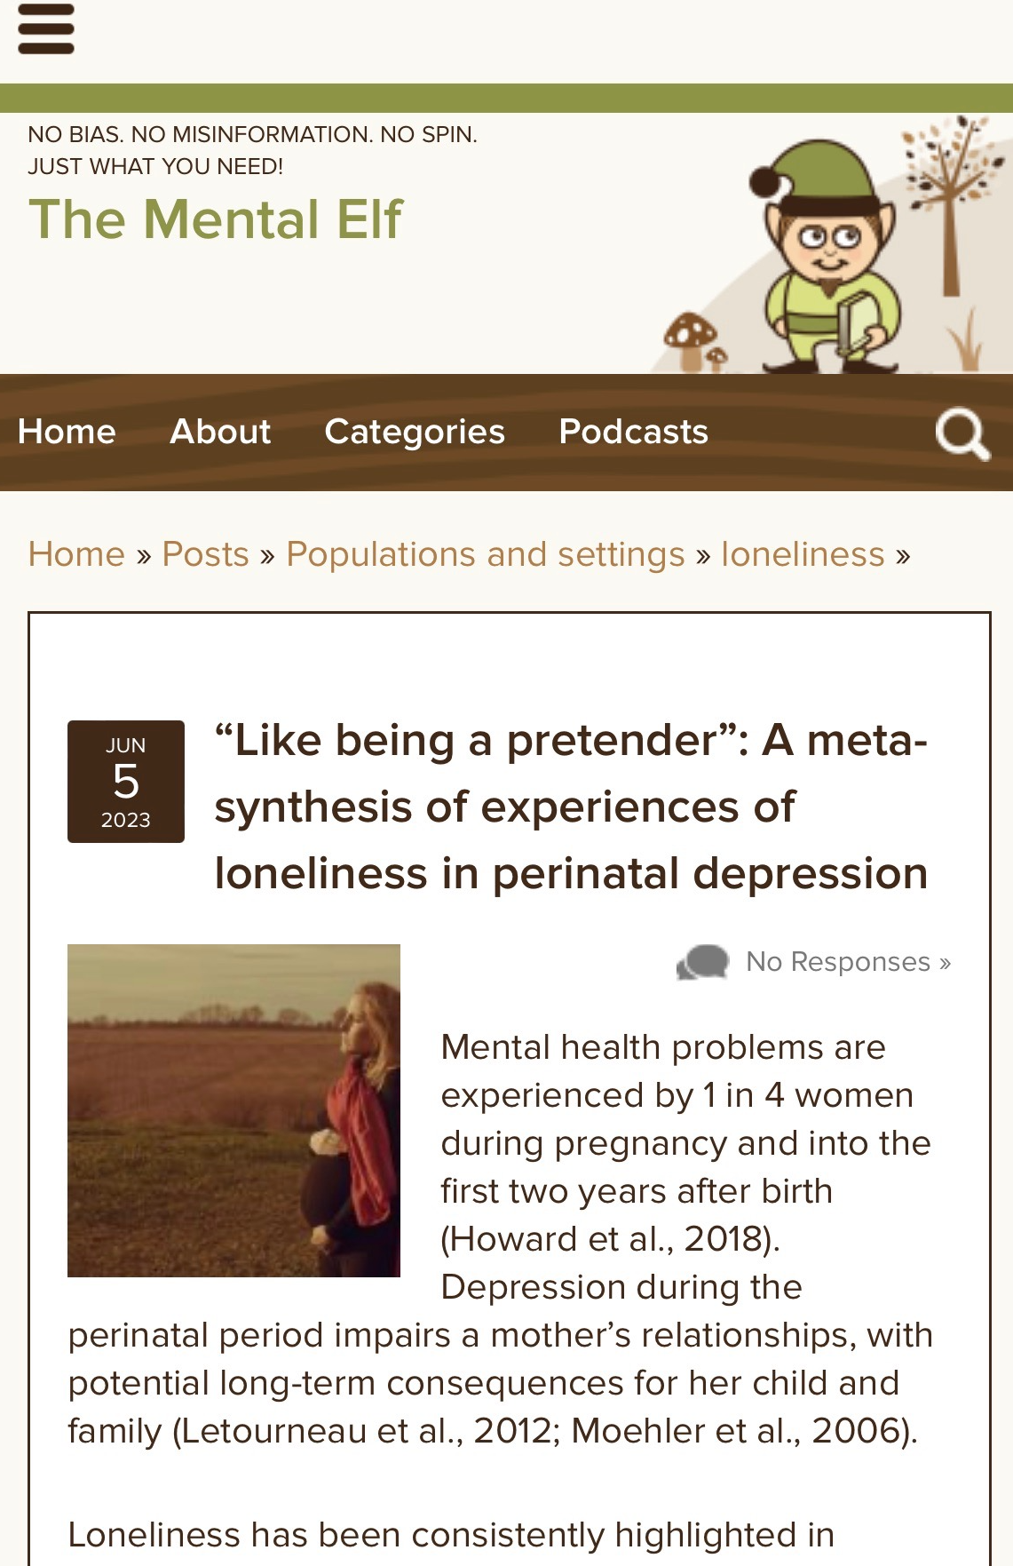
Published Feb 2023 in BMC Psychiatry
Notes:
There is a complex inter-relationship between loneliness & depression

Slide 23
References
Okagbue HI, Adamu PI, Bishop SA, Oguntunde PE, Opanuga AA, Akhmetshin EM. Systematic Review of Prevalence of Antepartum Depression during the Trimesters of Pregnancy. Open access Maced J Med Sci. 2019 May;7(9):1555–60.
Gavin NI, Gaynes BN, Lohr KN, Meltzer-Brody S, Gartlehner G, Swinson T. Perinatal depression: a systematic review of prevalence and incidence. Obstet Gynecol. 2005 Nov;106(5 Pt 1):1071–83.
Howard L, Khalifeh H. Perinatal mental health: a review of progress and challenges. World Psychiatry. 2020;19(3):313–27.
Sinclair D, Murray L. Effects of postnatal depression on children’s adjustment to school - Teacher’s reports. Br J PSYCHIATRY. 1998 Jan;172:58–63.
Aktar E, Qu J, Lawrence PJ, Tollenaar MS, Elzinga BM, Bögels SM. Fetal and infant outcomes in the offspring of parents with perinatal mental disorders: Earliest influences. Front Psychiatry. 2019;10(JUN):1–20.
Luoma I, Korhonen M, Puura K, Salmelin RK. Maternal loneliness: concurrent and longitudinal associations with depressive symptoms and child adjustment. Psychol Heal Med. 2019;24(6):667–79.
Co-operative. Shocking extent of loneliness faced by young mothers revealed [Internet]. 2018. Available from: https://www.co-operative.coop/media/news-releases/shocking-extent-of-loneliness-faced-by-young-mothers-revealed
Thomas J. Insights in loneliness, older people and well-being. United Kingdom: Office for National Statistics; 2015.
Smith KA, Howard LM, Vigod SN, D'Agostino A, Cipriani A. Perinatal mental health and COVID-19: Navigating a way forward. Aust N Z J Psychiatry. 2023 Jul;57(7):937-943. doi: 10.1177/00048674221137819. Epub 2022 Nov 28. PMID: 36440619; PMCID: PMC9708536.
Basu A, Kim HH, Basaldua R, Choi KW, Charron L, Kelsall N, et al. A cross-national study of factors associated with women’s perinatal mental health and wellbeing during the COVID-19 pandemic. PLoS One [Internet]. 2021;16(4 April):1–18.
Peplau L, Perlman D. Loneliness: a sourcebook of current theory, research, and therapy. New York: Wiley Interscience; 1982.
Meltzer H, Bebbington P, Dennis MS, Jenkins R, McManus S, Brugha TS. Feelings of loneliness among adults with mental disorder. Soc Psychiatry Psychiatr Epidemiol. 2013 Jan;48(1):5–13.
Lee SL, Pearce E, Ajnakina O, Johnson S, Lewis GG, Mann F, et al. The association between loneliness and depressive symptoms among adults aged 50 years and older: a 12-year population-based cohort study. The Lancet Psychiatry [Internet]. 2021;8(1):48–57. Available from: http://dx.doi.org/10.1016/S2215-0366(20)30383-7
Wang J, Mann F, Lloyd-Evans B, Ma R, Johnson S. Associations between loneliness and perceived social support and outcomes of mental health problems: A systematic review. BMC Psychiatry. 2018;18(1):1–16.
Ma R, Mann F, Wang J, Lloyd-Evans B, Terhune J, Al-Shihabi A, et al. The effectiveness of interventions for reducing subjective and objective social isolation among people with mental health problems: a system- atic review. Soc Psychiatry Psychiatr Epidemiol. 2020;55(7):839–76.
Mann F, Wang J, Pearce E, Ma R, Schleif M, Lloyd-Evans B, et al. Loneli- ness and the onset of new mental health problems in the general population: a systematic review. Soc Psychiatry Psychiatr Epidemiol. 2022;57(11):2161–78. Available from: http://medrxiv.org/content/early/ 2021/02/12/2021..26.21250587.abstract.
Beck CT. The lived experience of postpartum depression: a phenomenological study. Nurs Res [Internet]. 1992 May;41(3):166–70. Available from: http://search.ebscohost.com/login.aspx?direct=true&AuthType=ip,shib&db=jlh&AN=107489539&site=ehost-live&scope=site&custid=s8454451
Highet N, Purtell C, Stevenson AL, Coo S. Qualitative insights into women’s personal experiences of perinatal depression and anxiety. Women and Birth [Internet]. 2014;27(3):179–84. Available from: http://www.elsevier.com/wps/find/journaldescription.cws_home/707424/description#description
Schmied V, Naidoo N, Black E, Dahlen HG, Liamputtong P. Migrant women’s experiences, meanings and ways of dealing with postnatal depression: A meta-ethnographic study. PLoS One [Internet]. 2017;12(3):e0172385.
Lachal J, Revah-Levy A, Orri M, Moro MR. Metasynthesis: An original method to synthesize qualitative literature in psychiatry. Front Psychiatry. 2017;8(DEC).
Weiss RS. Loneliness: The experience of emotional and social isolation. Loneliness: The experience of emotional and social isolation. Cambridge, MA, US, MA, US: The MIT Press; 1973. xxii, 236–xxii, 236.
Achterbergh L, Pitman A, Birken M, Pearce E, Sno H, Johnson S. The experience of loneliness among young people with depression: a qualitative meta-synthesis of the literature. 2020;
Mauthner NS. “Feeling low and feeling really bad about feeling low”: Women’s experiences of motherhood and postpartum depression. Can Psychol Can. 1999;40(2):143–61.
Świtaj P, Grygiel P, Anczewska M, Wciórka J. Loneliness mediates the relationship between internalised stigma and depression among patients with psychotic disorders. Int J Soc Psychiatry [Internet]. 2013 Dec 16;60(8):733–40. Available from: https://doi.org/10.1177/0020764013513442
Notes:
There is a complex inter-relationship between loneliness & depression

Slide 24
Acknowledgements & declarations
  Thank you very much to the Patient Advisory Group
  Thank you very much to my collaborators and research team:
    Professor Sonia Johnson, UCL
    Dr Eiluned Pearce, UCL
    Dr Billie Lever-Taylor, KCL
    Dr Claire Wilson, KCL
    Dr Rebecca Nowland, University of Lancashire
    Cristina Vasquez-Bendezu, UCL
    Sarah Spring, Person with Lived Experience
  Research carried out as part of Mental Health Sciences Research MSc at UCL:
    Funding for PPI & access to Eppi-Reviewer received as part of study budget
  No relevant conflicts of interest to declare
Notes:
There is a complex inter-relationship between loneliness & depression

Slide 25

Thank you and any questions?
  katherine.adlington@nhs.net
  @kateadlington
Notes:
There is a complex inter-relationship between loneliness & depression

Slide 26


Perinatal Mental Health Project
A lived experience, community led approach to perinatal mental health services in Derby.

Slide 27
What Are the PMH Projects Aims?
To identify services across Derby and Derbyshire offering PMH (Perinatal Mental Health) services.
  To identify and understand core PMH services referral pathways and what they offer.
  To create a PMH Pathway, working to the ‘Thrive model’
To identify and explore what is working well for PMH services and their users.
To identify and explore any barriers experienced by PMH services and their users.
To provide recommendations to inform, improve, and shape future PMH services.

Slide 28
Co-production
Committed to ensuring that the community is involved through each stage of our project.
PMH Project is led by lived experience, service users and services.
Worked hard to ensure we facilitate all voices throughout each stage of the project.
Representation of Derbys Diverse community
  Ethnicity's
  LGBTQIA+
  Neurodiversity's
  Disabilities

Slide 29
Data Collection
Mixed methods approach
  Quantitative - Surveys for both service users and providers.
  Qualitative – Semi Structured themed listening sessions.
Surveys – services and service users asked the same questions, PMH, services accessed, barriers to support, Likert scale questions, space for personal experiences.
Listening sessions – did you access support, what worked, barriers to support, blue sky thinking what would services look like in the future.

Slide 30
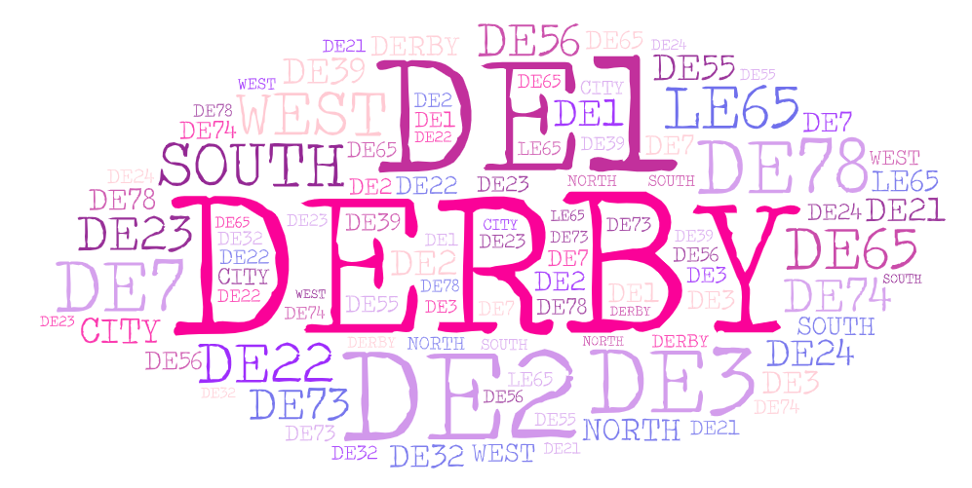
Service User Demographics
 | Been Pregnant | 76
 | Experienced pregnancy loss | 22
 | Experienced baby loss | 5
 | Given birth | 76
 | Given birth to a child who is no longer in your primary care | 0
 | Currently pregnant | 6
 | Experienced pregnancy termination | 3
 | Experienced birth trauma | 20
 | Accessed IVF | 6
 | Accessed conception support | 2
 | Accessed prenatal services | 24
 | Accessed postnatal services (for baby) | 26
 | Accessed postnatal services (for parent) | 27
 | Partner or family member of pregnant person | 2
89 service user responses
22% from a BAME background
Additional 9 paper responses from BAME community members

Slide 31
Service Provider Demographics
 | Local Independent Service | 1
 | Charity | 14
 | Community Based Organisation | 5
 | NHS Primary Care | 3
 | NHS Secondary Care | 14
 | NHS Other | 1
 | Other | 1
39 services responses from every sector
Online courses – 5
Peer support – 17
Talking therapies – 10
Parent and baby – 11
Dads and partners – 4
Family groups – 9
Psychological – 16
Holistic – 6
Other - 5

Slide 32
PMH Project Listening Sessions
Community One
Baby Loss
Pregnancy Loss
Young Parents
NICU
Dads and NB parents
Signing Families
Neurodiverse Families
Birth Trauma
Maternity Staff
Peer Supporters
Community Groups
PMH Drop in sessions

Slide 33
Emerging Themes
Positive impact on perinatal loneliness
Emphasis on the importance of community support.
Positive impact of shared experiences.
Positive breastfeeding support experiences.
Education and understanding.
Trauma informed and person led approaches.
Negative impact on perinatal loneliness
Lack of shared experiences
Drop off from support once baby is born.
Lack of education around PMH
Lack of support networks
Not knowing what services/support is available.

Slide 34
PMH and Perinatal Loneliness.
Interaction between PMH and Perinatal loneliness.
Creating sustainable, reliable and trusted support networks are crucial in supporting the reduction of perinatal loneliness.
  Community groups
  Peer support
  Specialist support
  Friends and family
Shared experiences can support the reduction of perinatal loneliness.
Education to reduce the stigma around PMH and loneliness.

Slide 35
Looking forward…
Final report and directory
What will the report include?
  Findings from all data collected and listening sessions
  Positives (what is working well for services)
  Gaps (what is Derby missing in terms of PMH support)
  Barriers (what barriers there are currently within Derbys PMH services)
  A clear pathway for mums, dads and partners on their journey in and out of the perinatal mental health service
What will the directory include?
  A full list of Derby-based services that offer PMH support
  What support they offer, referral pathway and contact details
Recommendations
  We will provide evidence-based recommendations on how services can be improved moving forward to better support parents and infant mental health and wellbeing.

Slide 36
Questions?
Any questions?
  Hannah.moore@perinatalsupport.org.uk
  07719064041
  Perinatal (ntropydata.co.uk)
  Pregnancy and Perinatal Support in Derby - Connected Perinatal Support CIC

Slide 37


Peer Support and Perinatal Loneliness
Charli Headley

Slide 38
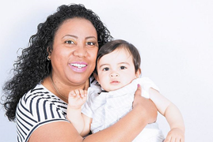

Mums Matter
8 week course for groups of women with a child under the age of 2
Developed by CPSL Mind/National Mind
Delivered in Children’s Centres with a creche for babies, with an on line option
Focus on peer support, validation of feelings and learning self care strategies and coping skills
Emphasis is on the mum and their well being to then engage with and access other support for themselves and their family
“Coming to this group feels like recharging for the week ahead; it’s our safe space”
Mums Matter peer support participant

Slide 39

Course content
Being a good enough mum
Looking after yourself, basic needs and self care
Exploring negative thinking patterns
Nurturing you and building self belief and esteem
Wellness action plan and recovery journey
Being kind to yourself and discovering you
Two unstructured sessions to develop peer support
Involving partners and supporters in a session to understand and support course learnings, in partnership with Dad Matters

Slide 40

4 volunteers with lived experience/course attendance recruited giving 70 hours of their time
85 families supported through courses, workshops, 1:1 support and signposting
6 eight week courses delivered in Children’s Centres/Family Hubs across North/Central/South Manchester
7 in person and WhatsApp peer support groups/forums accessed by 28 women
Activity
Nov 2022 – Dec 2023
“Listening to other Mums stories helped me name my own feelings and experiences. I have realised others are experiencing what I am experiencing and that I am not alone in this”

Slide 41



Outcomes
100% of women have reported that they feel:
A reduction in low mood and /or anxiety
More skilled in self-care and managing their well-being
More confident in being able to engage with services
More connected to others after accessing peer support
Questionnaires completed pre and post course with consistent reductions in anxiety and improvements in low mood and well being (WEMWBS, PHQ9, GAD7)
“It’s been amazing to speak to someone who will talk honestly and openly around Motherhood; you made me realise I’m a normal Mum!””

Slide 42
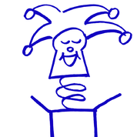
Loneliness: Impact and Findings
High uptake of WhatsApp Group invites
Friendships forged, that outlast the courses
A sense of ease and community as the course progresses
Shared experiences e.g. of mothering without your own mother
Better start for life for children “ Happy mums make happy babies ” – Mums Matter Volunteer
“Really lovely space to learn techniques to keep my cool – but better than that, a great space to connect with others ”

Slide 43


What do we need?
Long term funding to support the development of similar projects
Partnership work with other services to identify Mums who will benefit
More volunteer led peer support

Slide 44
It was very helpful for me to hear examples from other people’s lives
It gave me the awareness that getting out of my current state is possible

Slide 45
0161 769 5732 – Monday – Friday 10-3pm
info@manchestermind.org
www.manchestermind.org
Charli Headley
Mums Matter Co-Ordinator
Charli.headley@manchestermind.org

