Slide 1


Amplifying Maternal Voices toolkit
Perinatal Loneliness conference - 18 September 2024

Slide 2
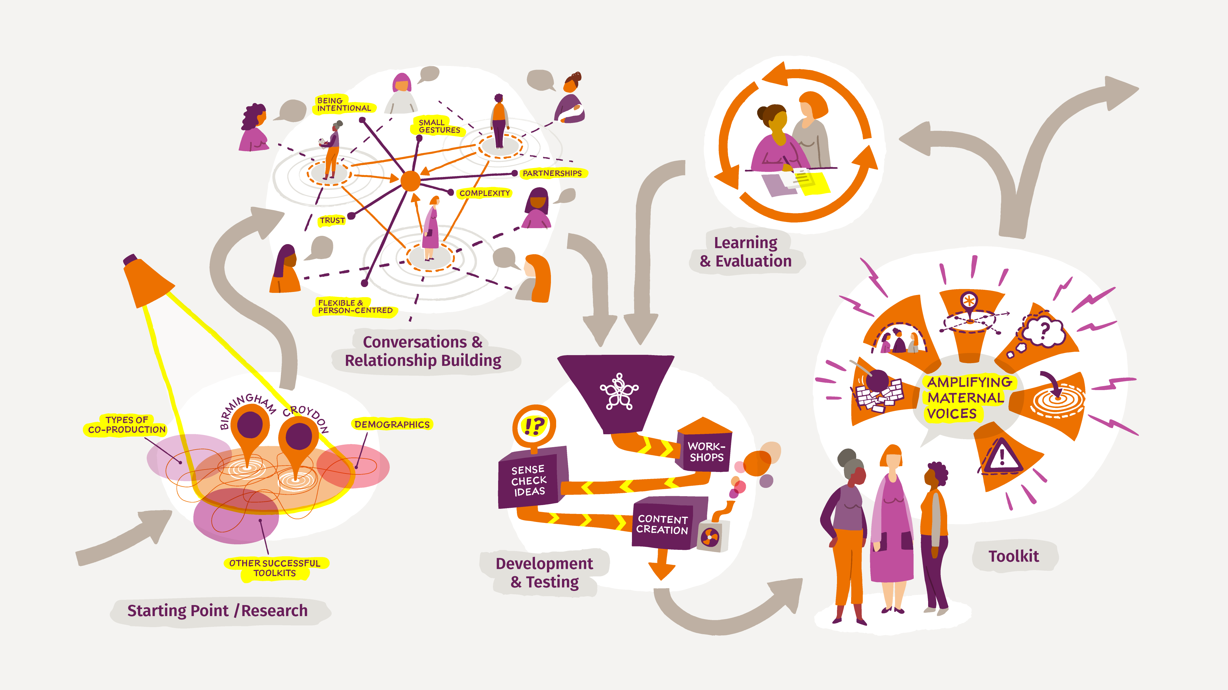
Amplifying Maternal Voices toolkit journey

Slide 3



Audience and purpose
A resource for individuals and groups across the UK who want to influence decision makers and create positive change in perinatal mental health care in their local area.
We hope it will inspire action at a local level and be a platform to amplify seldom-heard voices.

Slide 4



What we’ve heard
“Isolation and loneliness are two of the biggest factors affecting mental health.”
“Representation is key when you feel alone in your motherhood journey and all you want is to encounter or hear about someone who feels and looks like you.”
Michelle
MMHA Lived Experience Champion
Maela
MMHA Lived Experience Champion

Slide 5
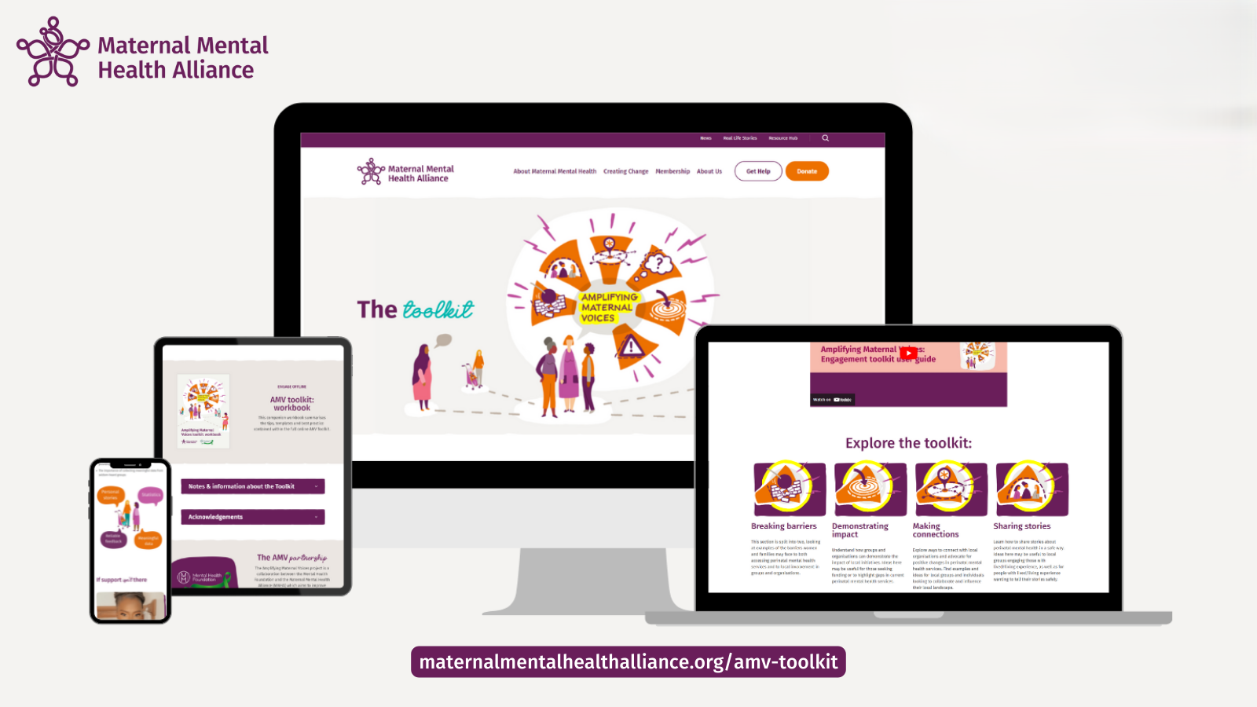

maternalmentalhealthalliance.org/amv-toolkit

Slide 6
Thank you!
Visit the Amplifying Maternal Voices toolkit
maternalmentalhealthalliance.org/amv-toolkit
Share: @MMHAlliance
Contact: sian@maternalmentalhealthalliance.org

